Slide 1
Using the Color Wheel
Color mixing and color theory
Have more fun painting!
Mark Geiger
Friday, December 3, 2021
10:00 to 12:00
Spring Hill Community Center
8946 Yellow Daisy Place
Lorton, VA 22079

Slide 2
Using the Color Wheel
Objectives
Learn how to mix colors when painting
Improve skill at understanding color schemes using in painting – art appreciation
Learn and apply some basic color mixing techniques
Background
• Color mixing is often challenging -both to the beginner and experienced artist
• It can be difficult to reproduce the same color
• Common errors lead to less intense colors - mud and frustration

Slide 3
Introduction
General background and introduction
The spectrum of visible light
What are primary colors – of reflected light from colored surfaces (and paints)
Using the color wheel to predict color mixing outcome.
Limitations -using light reflected from the paint pigment and underlying paper

Slide 4
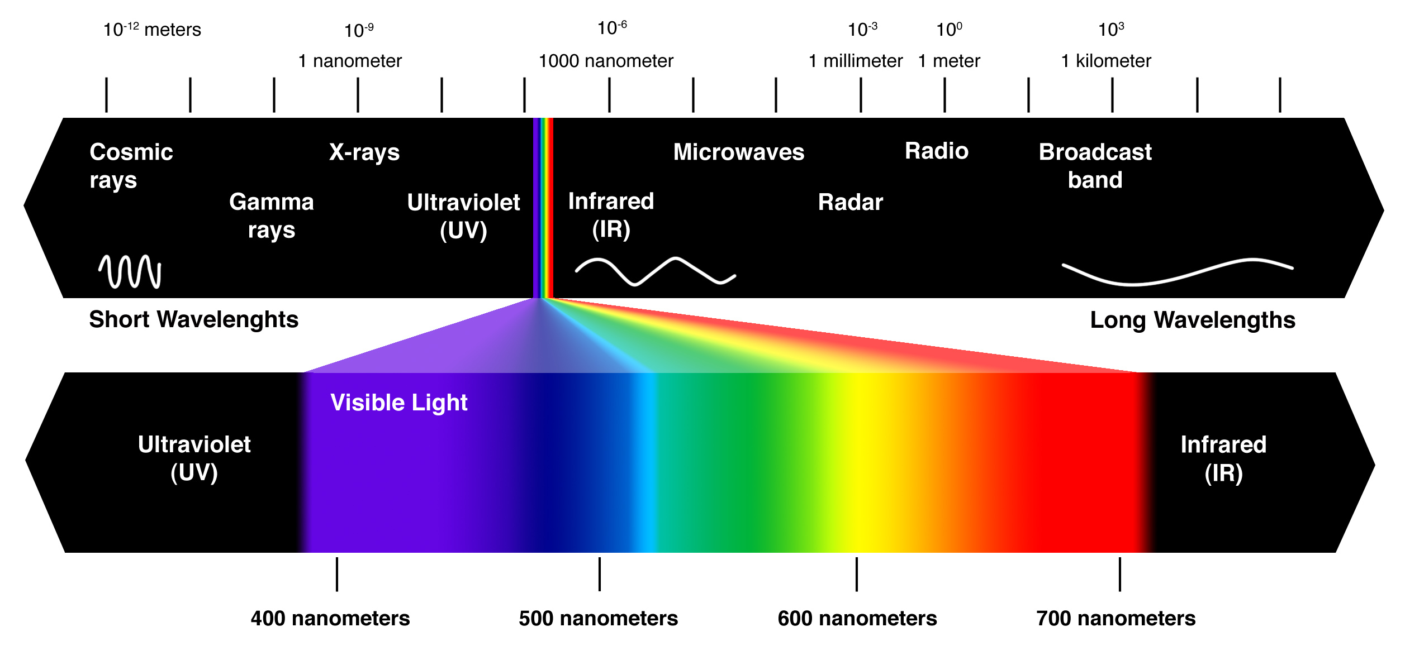
Light Spectrum
Narrow range of visible light
But still marvelous

Slide 5
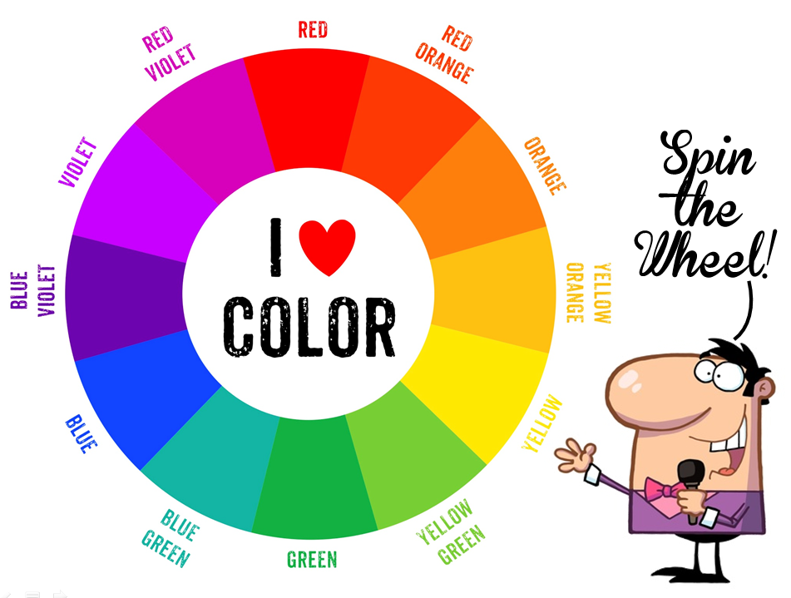
Color wheel incorporates some key colors into a simplified scheme for mixing and matching
What are primary colors – of reflected light from colored (and paints)
Using the color wheel to predict color mixing outcome.
Limitations -using light reflected from the paint pigment and underlying paper

Slide 6
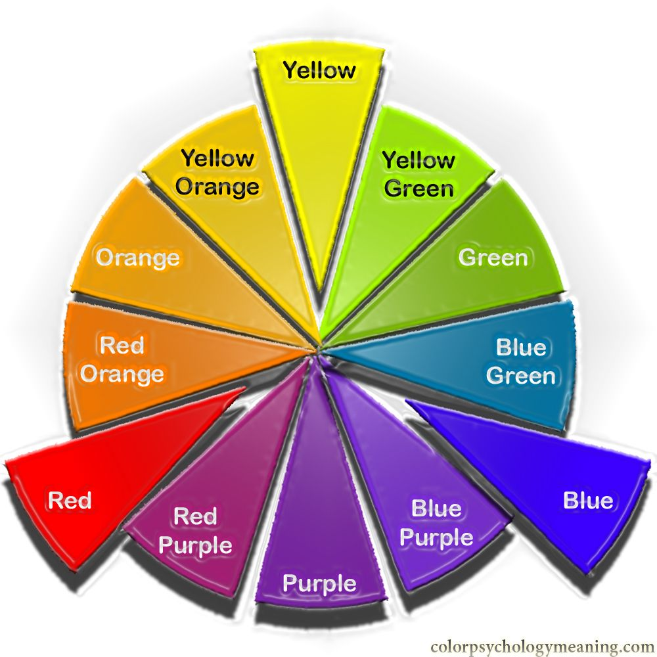
Primary colors used to make a triangle
Not a perfect solution- but workable
Primary color used to mix other colors.
These aren’t the only colors, but seem to work best and most consistently
Yellow
Red
Blue

Slide 7
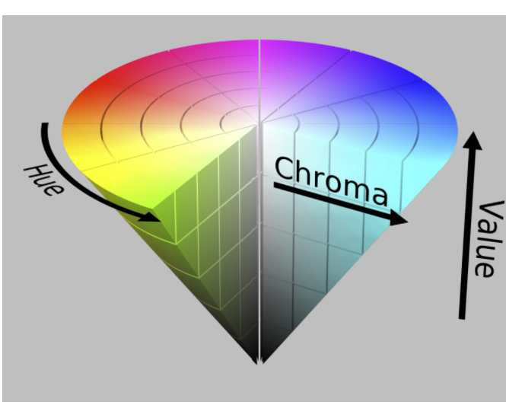
Some basic terminology https://blog.thepapermillstore.com/color-theory-introduction-color-wheel/
Hue- Frequency
Saturation: Also referred to as “chroma”, “saturation” refers to the purity of a hue. Saturation ranges from pure color (100%) to gray (0%).
Value – intensity refers to darkness or lightness of a color

Slide 8
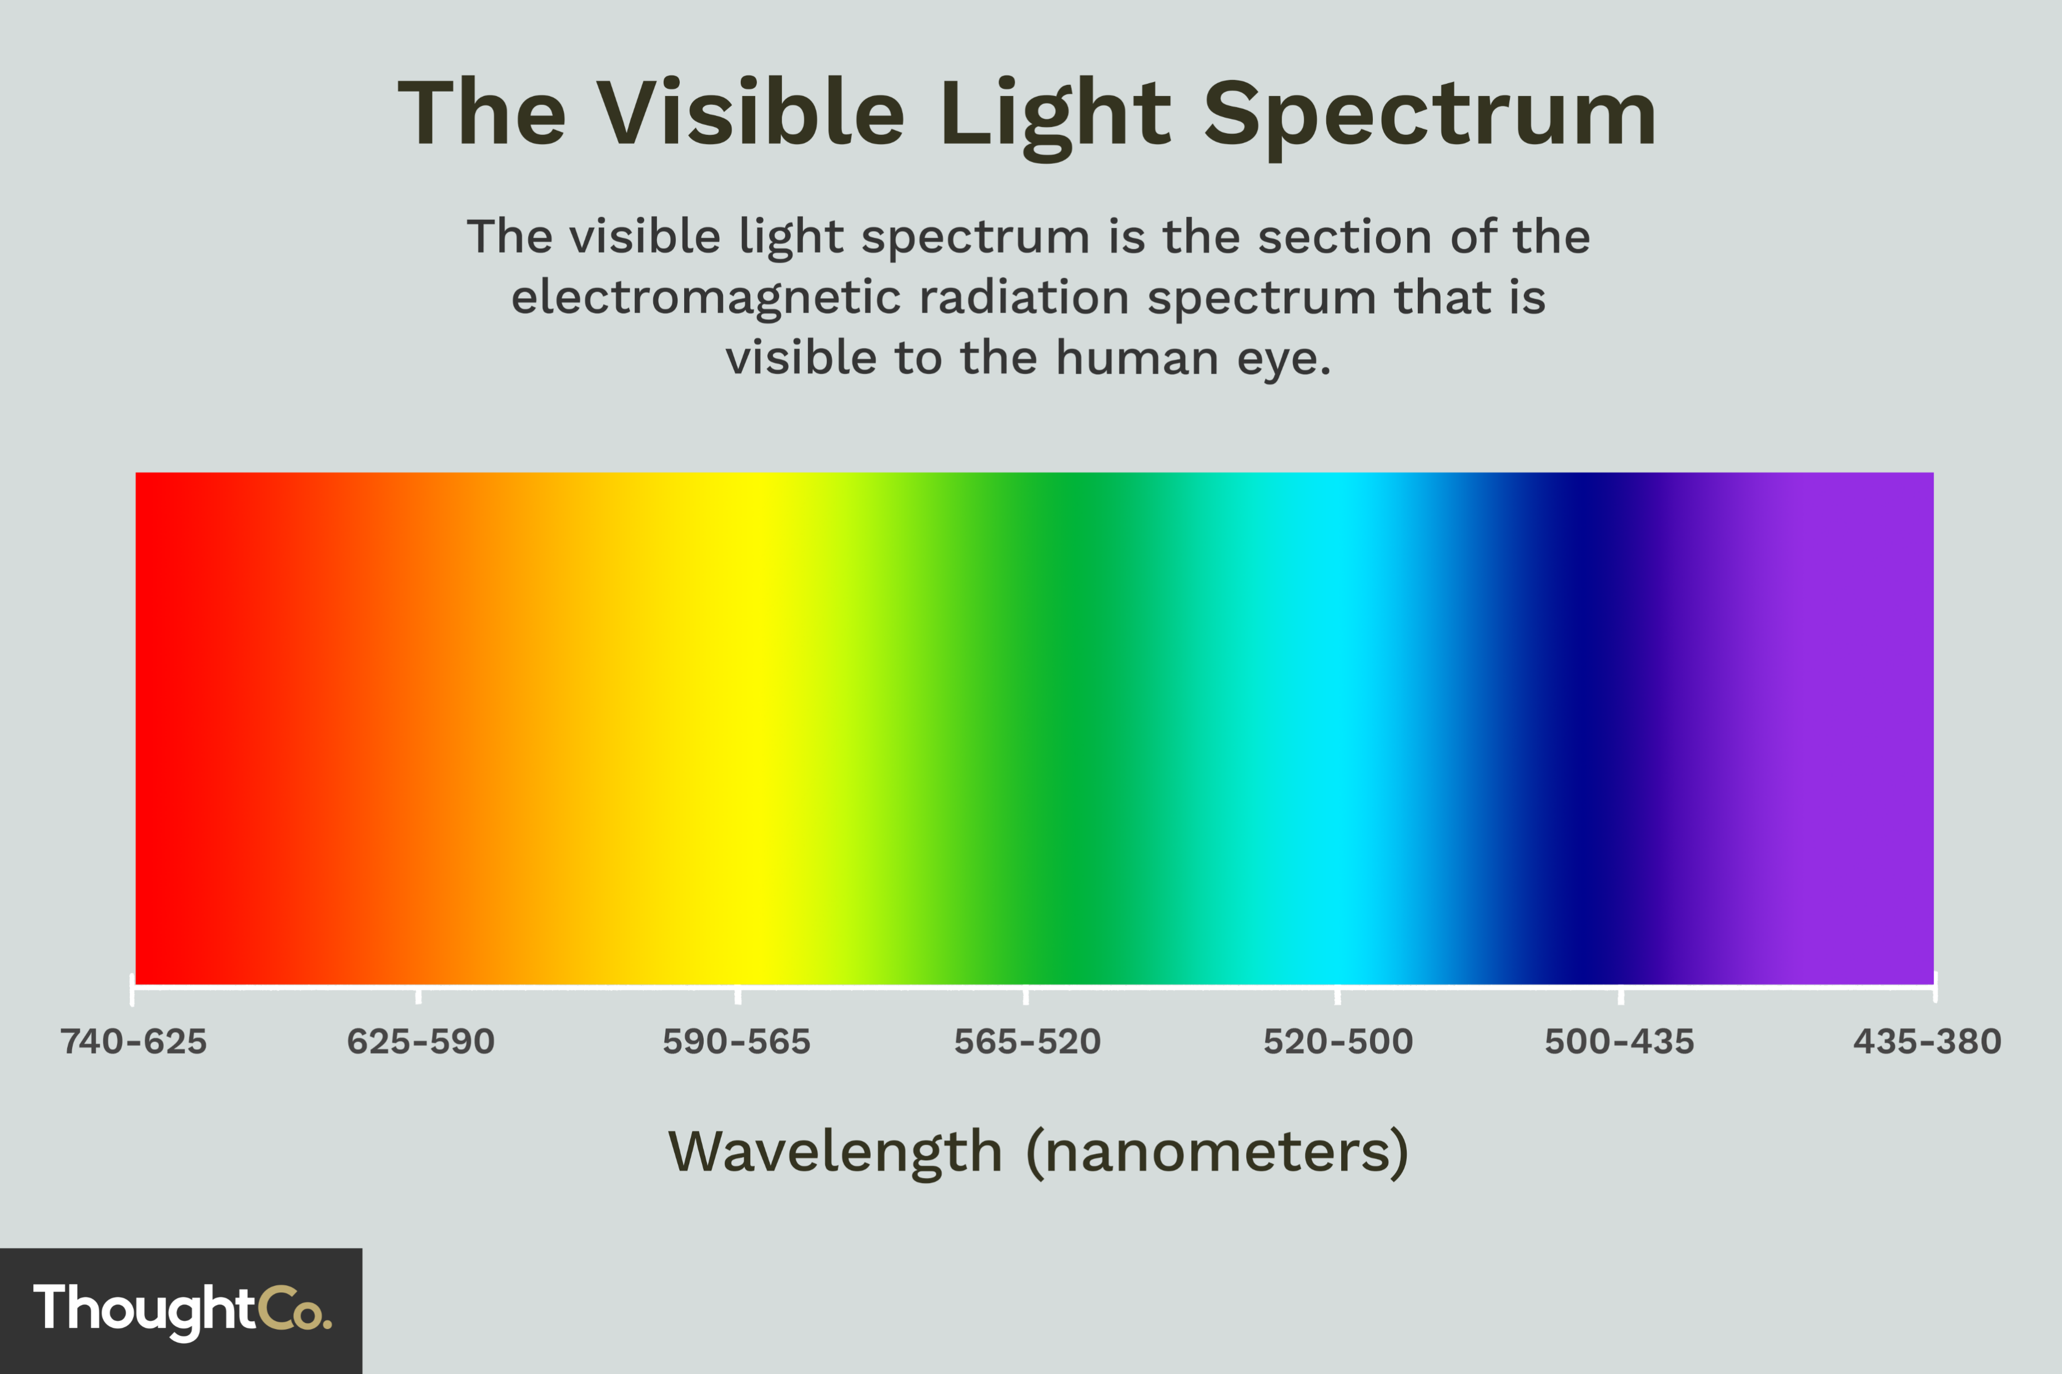
Primary colors used to make a triangle
Not a perfect solution- but workable
Primary color used to mix other colors.
These aren’t the only colors, but seem to work best and most consistently
Yellow
Green (in the middle)
Orange (in the middle)
Red
Blue

Slide 9
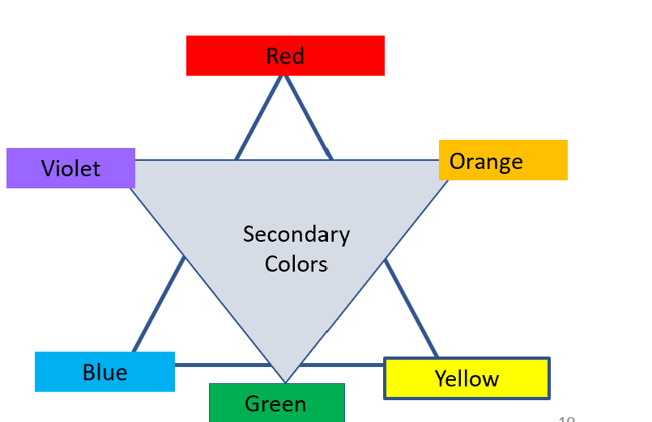





Exercise: Primary and Secondary color mixing
Christmas tree scenario
yellow and blue -> green
Red is the complement of green
The addition of red next to green can strengthen to green by contrast
The addition of red to green can “tone down” the intensity of complementary colors

Slide 10


Exercise: Primary and Secondary color mixing
Christmas tree scenario
Red is the complement of green
The addition of red next to a green can strengthen the green image by contrast

Slide 11





Exercise: Primary and Secondary color mixing
Christmas tree scenario
Red is the complement of green
The addition of red next to green can strengthen the green by contrast
The addition of red to green can “tone down” the intensity of complementary colors
Adding too much will make grey or black- all the colors are absorbed
Adding green can “tone down” the pure red

Slide 12
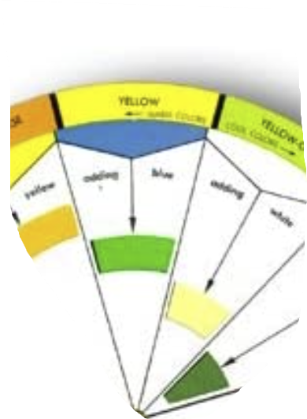
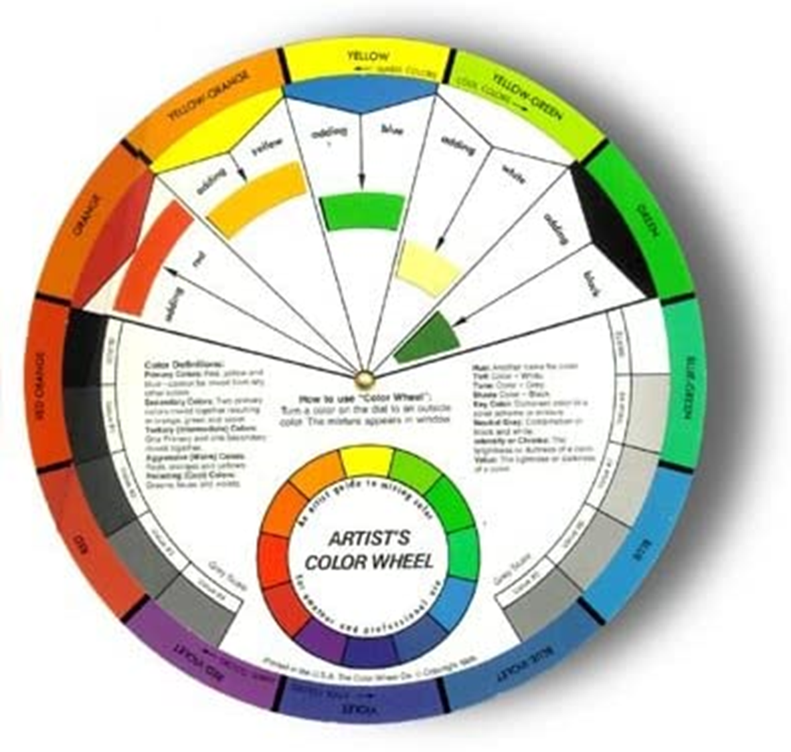

Use of the Color Wheel to Predict Color Mixing
Rotate the wheel to show the effect of color mixing
Yellow
Plus
Blue
Makes
Green

Slide 13



Color Triangles
Primary -reflected colors used for paint mixing– red- yellow- - blue
Mixing Primary colors to make secondary colors and find complementary colors
Red
Primary Colors colors
Violet
Orange
Secondary Colors
Blue
Yellow
Yellow
Green

Slide 14
Color Triangles
The Art of Color: Color Wheel & Color Relationships
online.maryville.edu/liberal-arts-degrees/the-art-of-color/
Primary colors include yellow, blue, and red. These are colors that can’t be created by mixing of other colors. Instead, they combine to create secondary colors, which in turn combine to create tertiary colors. In effect, all colors stem from the three primaries.
Secondary Colors
Definition of secondary color. : a color formed by mixing two primary colors in equal or equivalent quantities. https://www.merriam-webster.com/dictionary/secondary color
Complementary colors
One of two colors (such as red and green) that are very different from each other and produce a dull color (such as brown or gray) when they are mixed together
Mixing Primary colors to make secondary colors and find complementary colors
Violet
Orange
Secondary Colors
Yellow
Green

Slide 15






















Fall leaves scenario yellow and red -> orange
Materials
Red and yellow and blue paint
Brush or sponge (for leaves)
Background color (blue and yellow a lighter green)

Slide 16
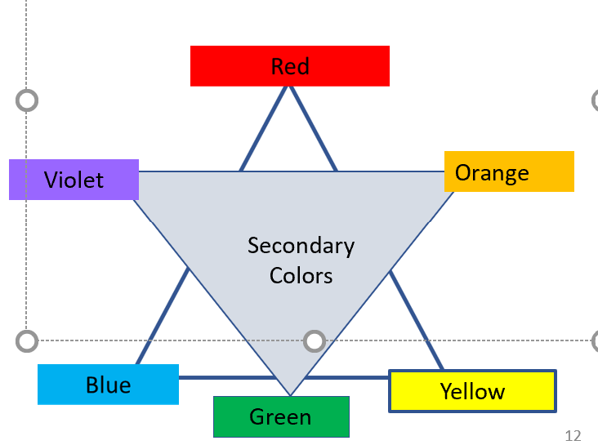
Applying a color triad
Mixing in blotches – let the eye help with the mixing
Can include using sponges to apply patches of color simulating foliage
Blue – sky color is the complement – use it to intensify the apparent color of leaves
Purple in the background complements yellow
Green in the background complements and intensifies reds
Can use color washes (blue for the sky, muted green for the ground) to provide complementary colors that enhance the intensity of the leaves (bright colors)

Slide 17
Fall leaves scenario –
Using primary colors and complements
Autumn Leaf color | Primary color | Added colors | Complement | Notes- most complements modulated to increase contrast
Red | Red | None | Green | Green in the background. Modulate with red to make the contrast stronger
Yellow | Yellow |  | Purple | Purple in the background
Orange |  | Red and yellow | Blue | Use the sky to highlight oranges
Materials
Red and yellow and blue paint, Brush or sponge (for leaves)
Background color (blue and yellow a lighter green), Hint: Brown is made with green, red and blue

Slide 18
Preparing the background – good for most landscapes
Sky – dark blue on the top, lighter at the horizon
Water wash technique
Dark blue on top,
Tilt the paper and brush down to dilute the color
Turn the paper upside down for gradient of green ground

Slide 19
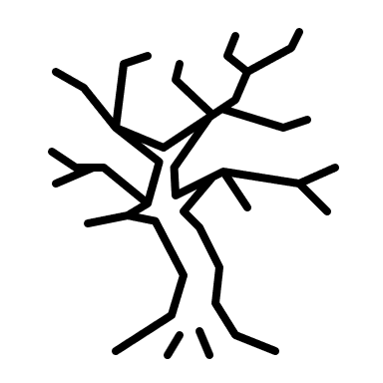
Using complementary colors – fall leaf scenario
Step 1- Put in a light background wash for the sky
Step 2- Turn the paper over and put in a light background wash for the ground
Step 3- draw a limited outline of the trees
Step 4 Add leaf colors and have fun
Step 5 –If time, add complementary color outlines to highlight brighter colors
Step 1 Wash for the sky – bluer on top
Step 3 draw tree outlines
Step 2 – light wash for the ground (turn the paper upside down)

Slide 20

Using complementary colors – fall leaf scenario
Step 1- Put in a light background wash for the sky
Step 2- Turn the paper over and put in a light background wash for the ground
Step 3- draw a limited outline of the trees
Step 4 Add leaf colors and have fun
Step 5 –If time, add complementary color outlines to highlight brighter colors
Step 1 Wash for the sky – bluer on top
Step 3 draw tree outlines
Step 2 – light wash for the ground (turn the paper upside down)

Slide 21
Admire your work and review
Mixing in blotches – let the eye help with the mixing
Mixing can include using sponges to apply patches of color simulating foliage
Blue – sky color is the complement of orange– use it to intensify the apparent color of leaves
Purple in the background complements yellow
Green in the background complements and intensifies reds

Slide 22
More Exercises – Time and Patience Permitting
Using thin layers of paint – let the paper provide the reflected light
Using thin overlapping layers of paint to allow light mixing
Close placement of color- be an impressionist and let the eye do the mixing
Colors can be applied with sponges in patches

Slide 23
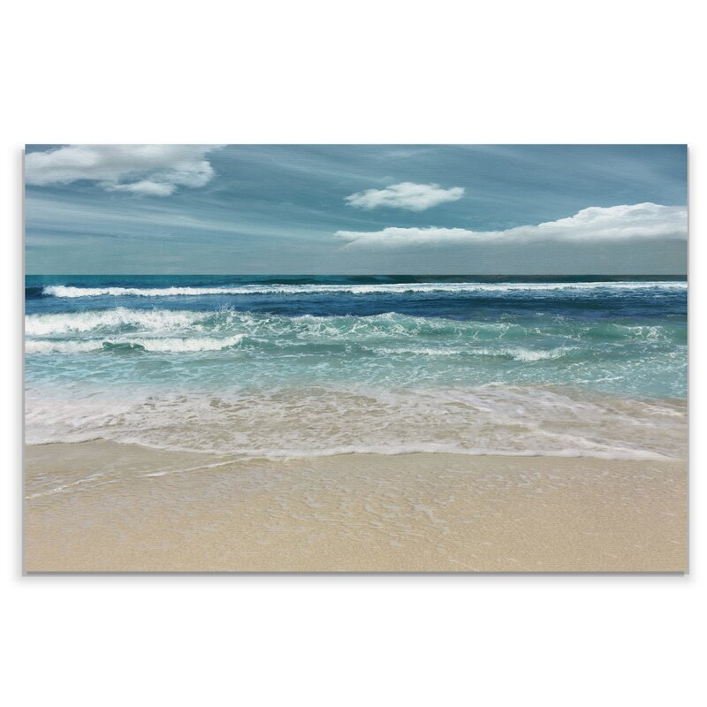
Seascape in washes of paint for color mixing

Slide 24
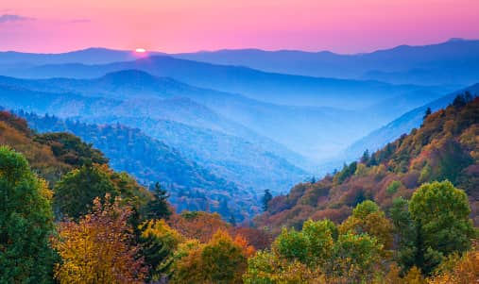
Atmospheric effects and color mixing
http://en.wikipedia.org/wiki/Appalachian_Mountains

Slide 25
More theory- time and patience permitting
Mixing with reflective colors is a subtractive process
Limit the pallet to a few colors -ideally in the complementary ranges
Too many colors = less color!
How to (partially) overcome the subtractive nature of paint mixing
Examples of triads in painting
Red, yellow and green aren’t the only options
Some examples from varied painters

Slide 26
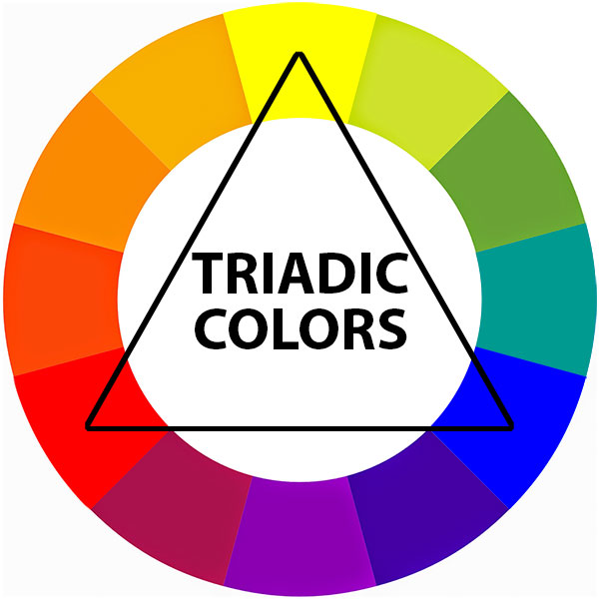
Triads in art
A triad color scheme consists of three chosen colors that are equidistant, or equally spaced, on the 12-point color wheel. Fine artists often use triads in works of art, and In interior design, triad color schemes link colors in unexpected combinations that add style and originality to a space.

Slide 27
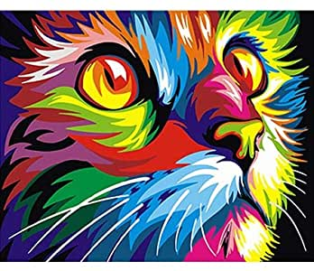
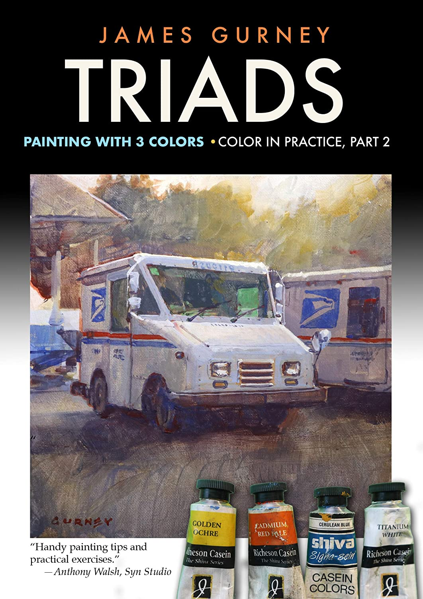
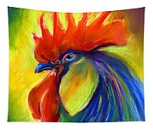
Triads
https://images-na.ssl-images-amazon.com/images/I/51TssQP1uwL.__AC_SY300_QL70_ML2_.jpg
Rooster Svetlana Novikova

Slide 28
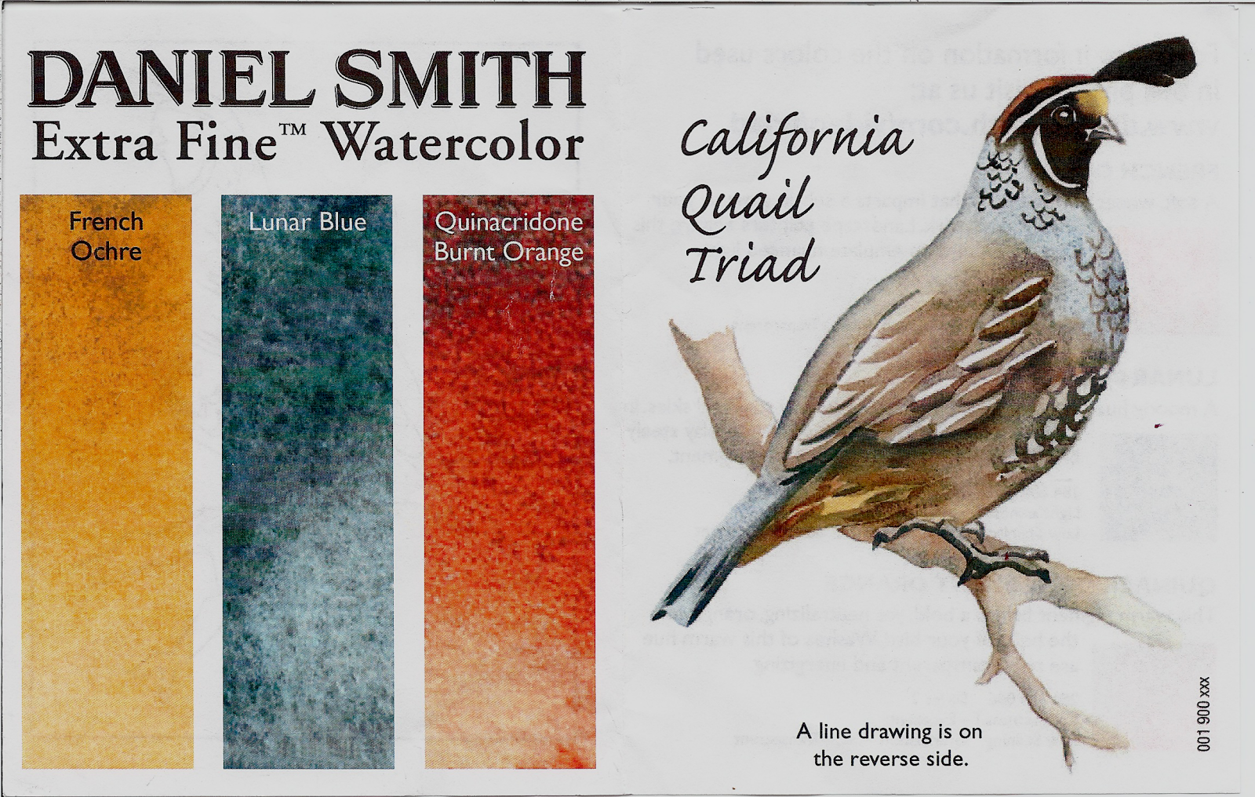

Non-primary color triads

Slide 29
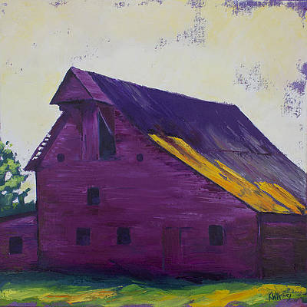
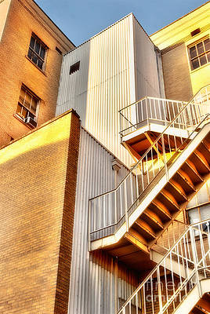
Non-primary triads in art
Can you guess which colors form the triangle?
Fuchsia Barn Print Kristin Whitney
Up the Down Staircase
Dan Carmichael

Slide 30
More color background
Time and Patience Permitting
Color mixing – eye and brain
Additive and subtractive processes
Isaac Newton and light

Slide 31
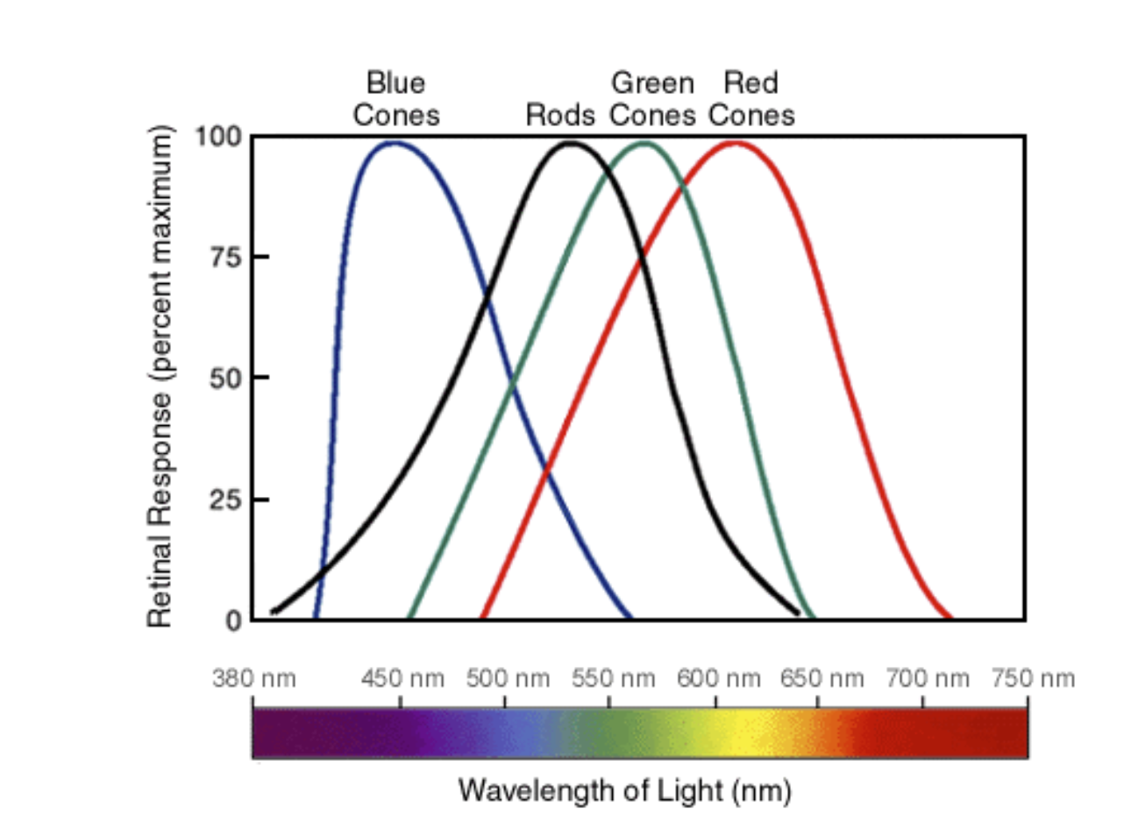
So why does red pigment when mixed blue pigment produce something which looks purple?
The red pigment reflects red light, and the blue pigment reflects blue light. These colors of light will reach our eyes and activate the blue and red sensitive cones. This dual stimulation is perceived by our brains to look something like a purple color even though no purple color light is being reflected by the mix of red and blue pigments!
scienceisforkids.wordpress.com/2015/01/09/why-does-red-and-blue-pigment-make …
https://physics.stackexchange.com/questions/122601/why-does-adding-red-light-with-blue-light-give-purple-light
Purple: It’s (almost) all in the mind!

Slide 32
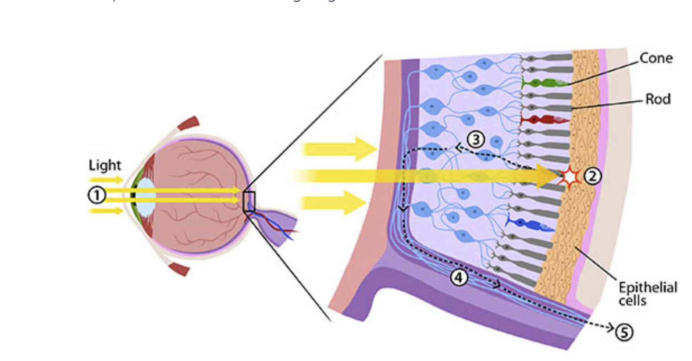
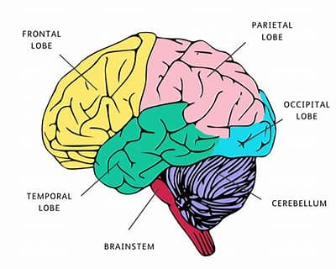
So why does red pigment when mixed blue pigment produce something which looks purple?
Purple: It’s (almost) all in the mind!
Blue light triggers blue-sensitive cones
Red light triggers red-sensitive cones
Nerve signals are transmitted to the brain where they are integrated to show a “new” color - violet
Notes:
We have three types of cones. If you look at the graph below, you can see each cone is able to detect a range of colors. Even though each cone is most sensitive to a specific color of light (where the line peaks), they also can detect other colors (shown by the stretch of each curve).
Since the three types of cones are commonly labeled by the color at which they are most sensitive (blue, green and red) you might think other colors are not possible. But it is the overlap of the cones and how the brain integrates the signals sent from them that allows us to see millions of colors. For example, the color yellow results from green and red cones being stimulated while the blue cones have no stimulation.

Slide 33
Rods and Cones in the Eye
Type of Receptor | Rods | Cones | Notes
Function | See shapes in black and white | Color sensitive | Color vision results from comparisons between cone responses
Types | One type | 3 types | Red, green and blue/violet
Color sensitive | No | Yes
Response | Fast | Slow
Amplification | High | Lower
Ability to see in low light | Good | Low
Number | 100 million | 6 million
• Ask a Biologist (University of Arizona) https://askabiologist.asu.edu/rods-and-cones
https://www.cis.rit.edu/people/faculty/montag/vandplite/pages/chap_9/ch9p1.html

Slide 34
Why does red pigment when mixed blue pigment produce something which looks purple?
The original article
VISUAL PIGMENTS OF RODS AND CONES IN A HUMAN RETINA J. K. BOWMAKER* AND H. J. A. DARTNALL
J. Physiol. (1980), 298, pp. 501-511
https://www.ncbi.nlm.nih.gov/pmc/articles/PMC1279132/pdf/jphysiol00783-0492.pdf

Slide 35
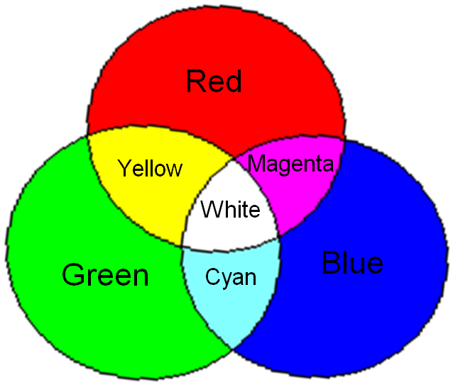
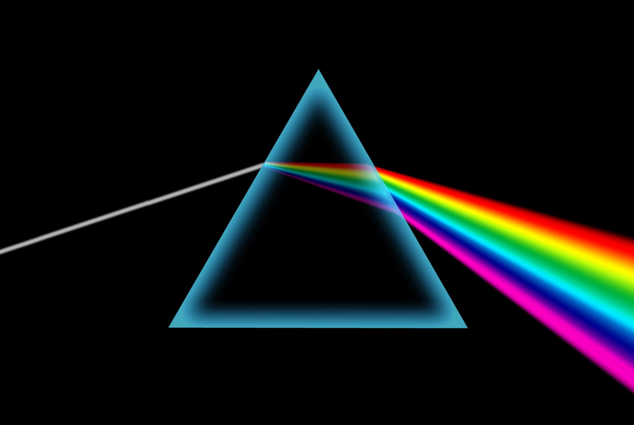
Color mixing with light

Slide 36
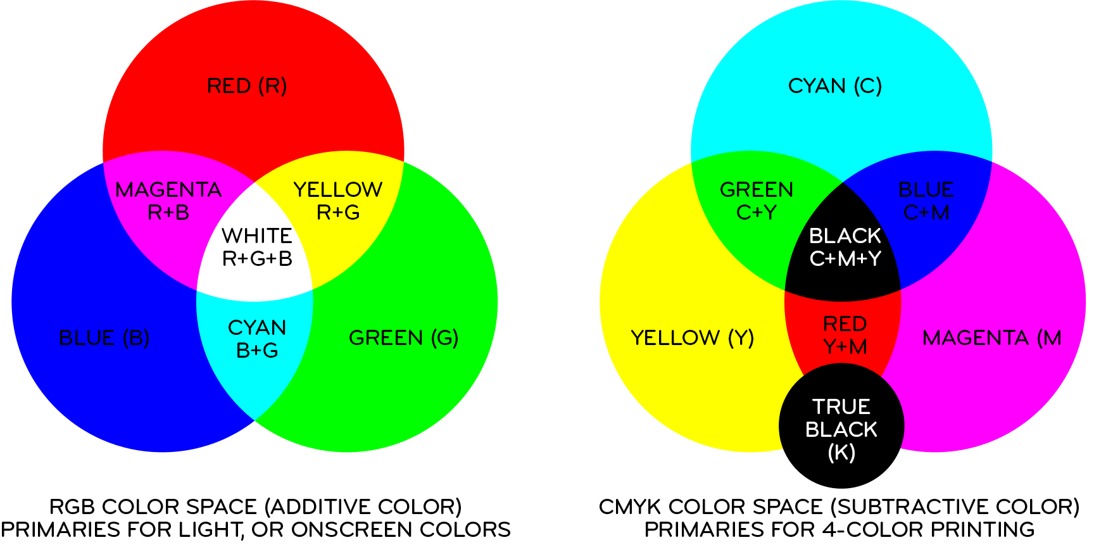
Mixing colors with light versus pigments

Slide 37
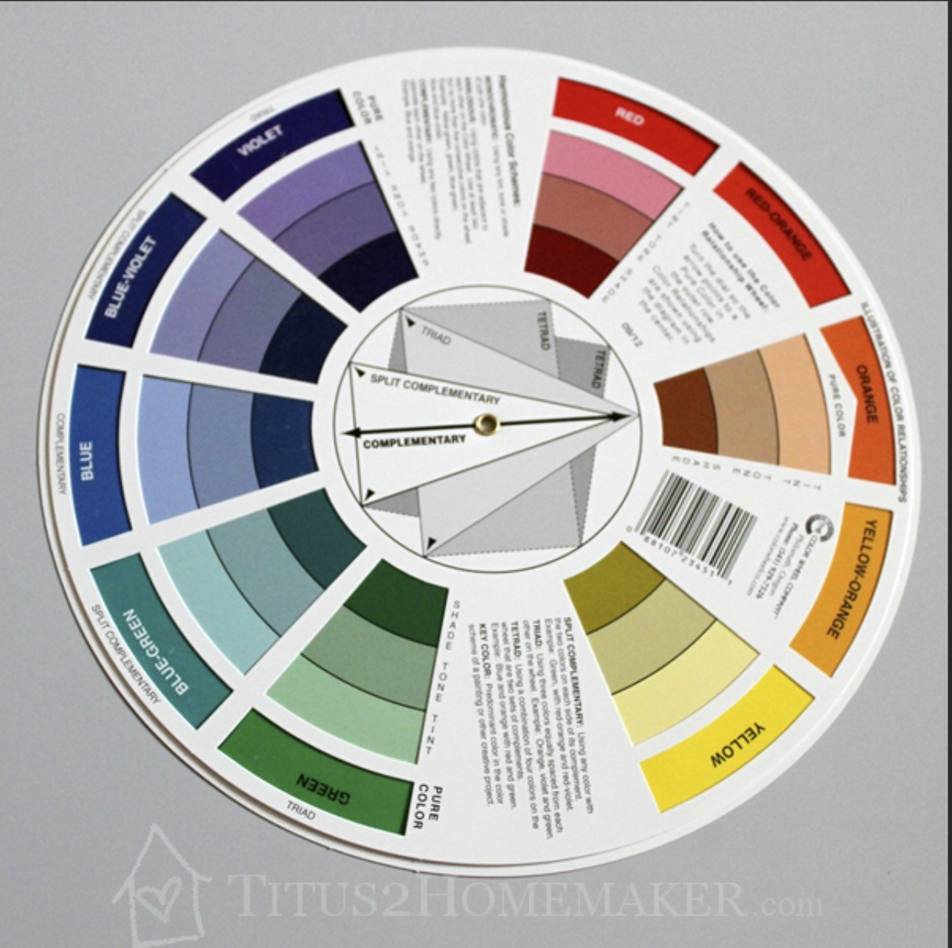

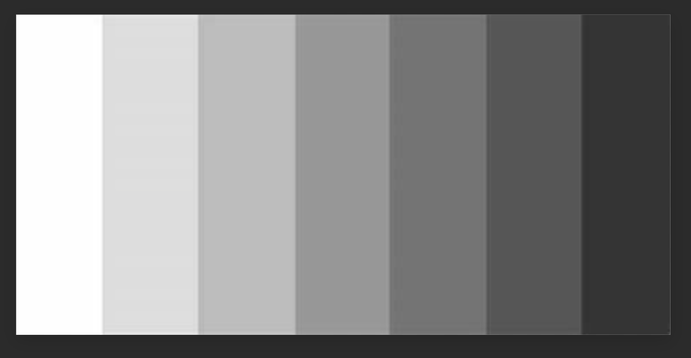
Reverse side of the color wheel
Color – described by three factors
Hue- name of the color
(location on the light spectra)
Value- relative darkness or lightness compared to a grey scale
Intensity- chroma purity of a color which determines its relative brightness or dullness (% transparency)
Yellow
0%
33%
67%

Slide 38
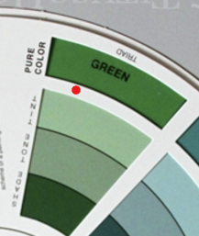
Reverse side of the color wheel
Pure color
Tint = color plus white
Tone = color plus grey
Can also be achieved by adding the complementary color
Shade = color plus black
Green

Slide 39
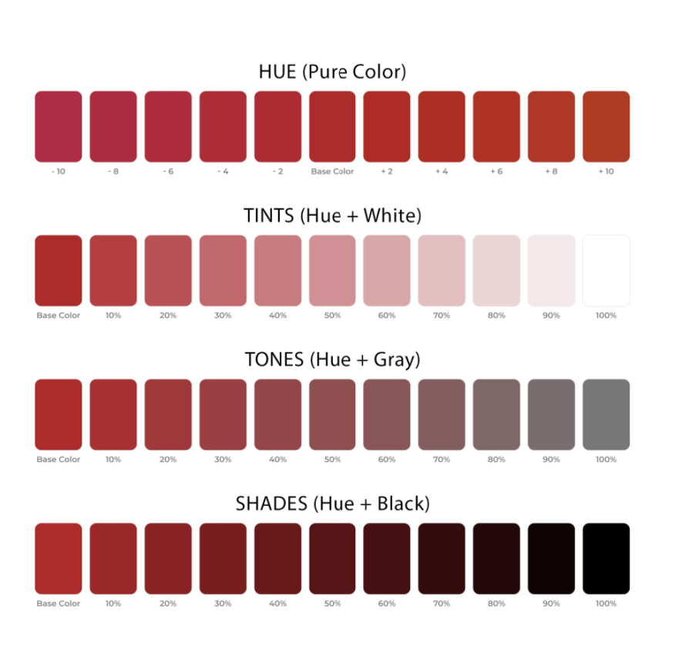
Colors and mixture with white, grey and black https://www.color-meanings.com/monochromatic-color-schemes

Slide 40
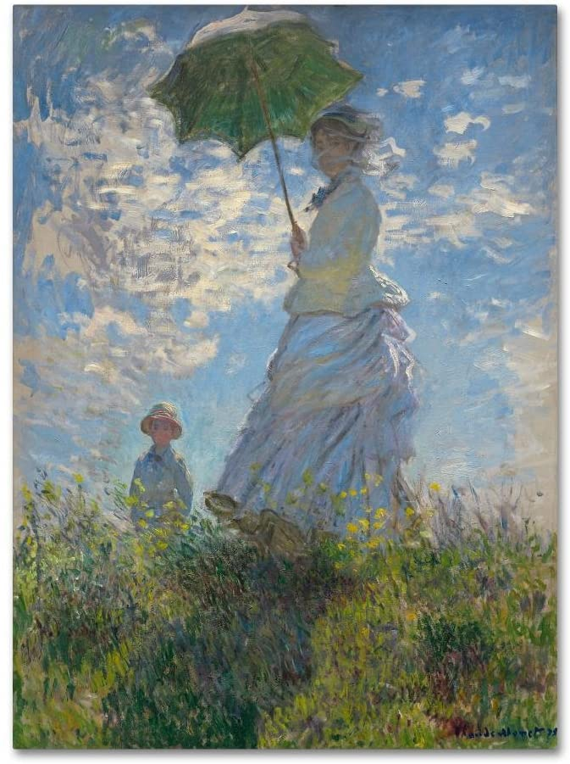
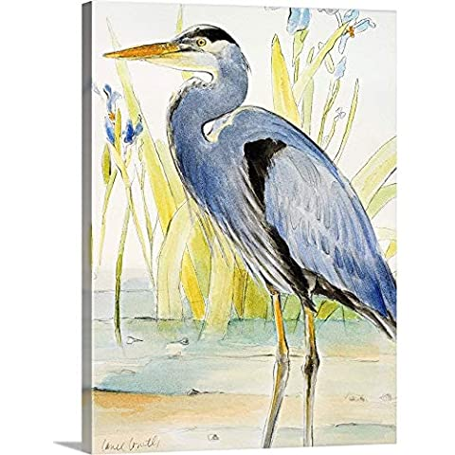
Simple Color and Monochromatic Paintings
Monet – Madame Monet and her son

Slide 41

Review and Summary
Use of color wheel- technique for color mixing (repeatably)
Use of complementary color to strengthen or modulate surrounding color
Letting the eye do some of the mixing
Layer of colors – let the paper provide some of the light
Some physiology – how light and color are mixed
Analyzing other’s paintings and color schemes.
Other side of the color wheel – grey scales, hue, value and intensity

Slide 42
Back-up slides

Slide 44
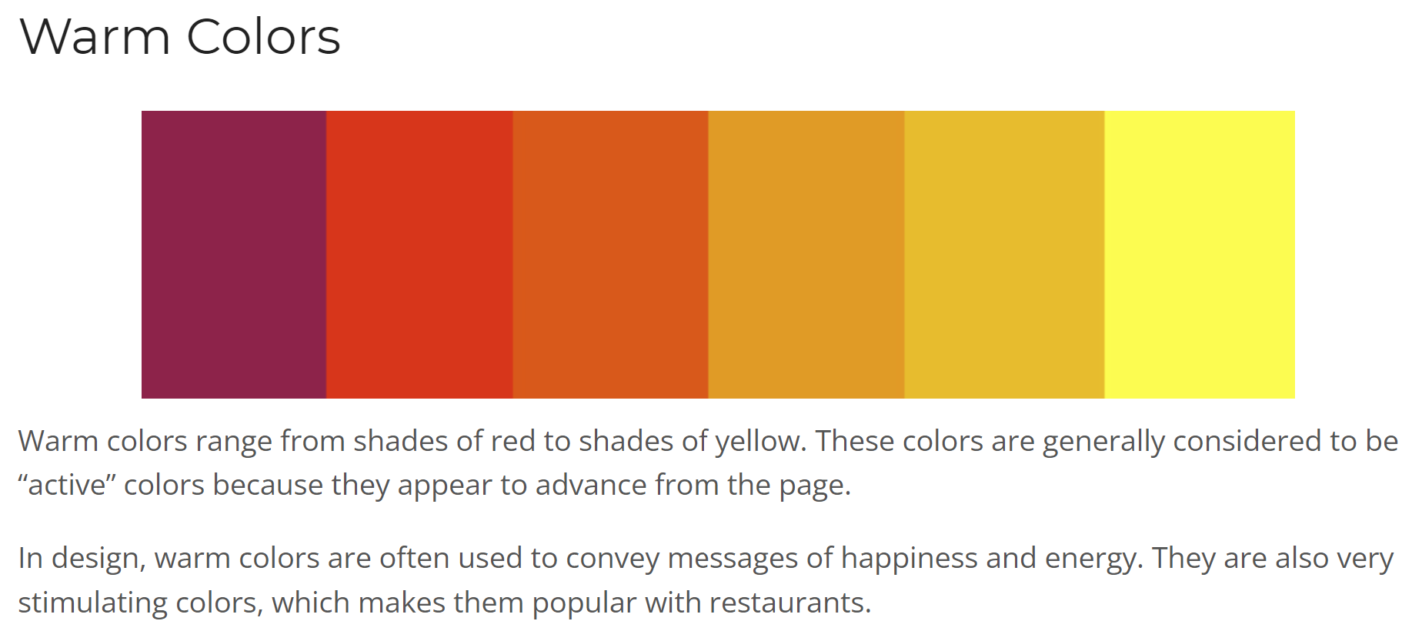
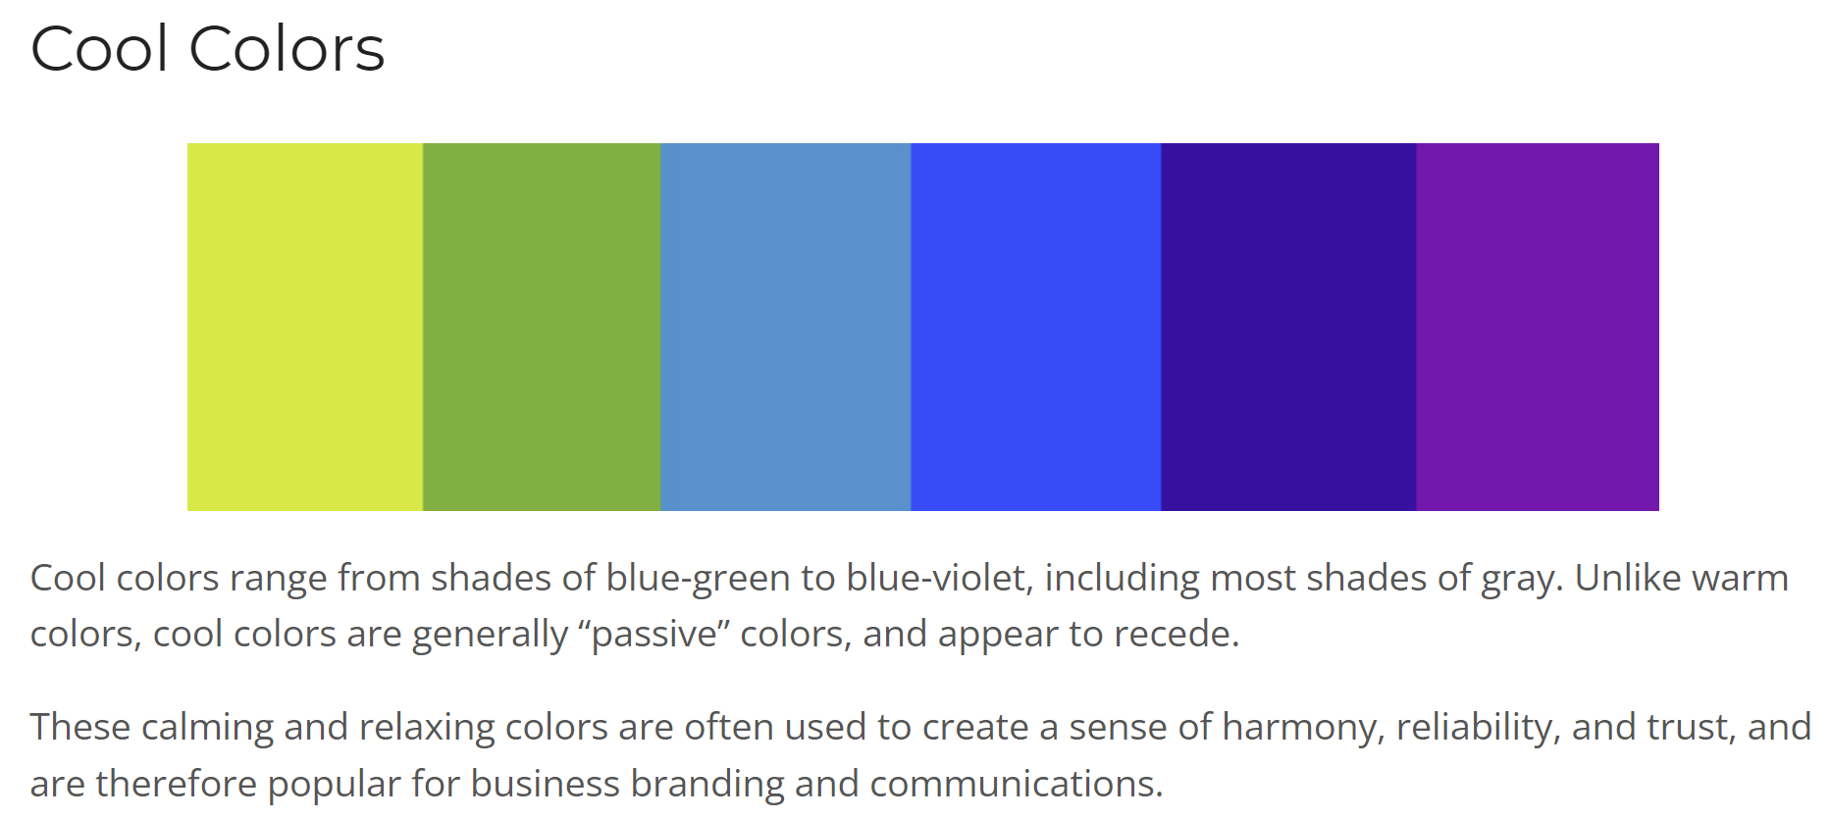
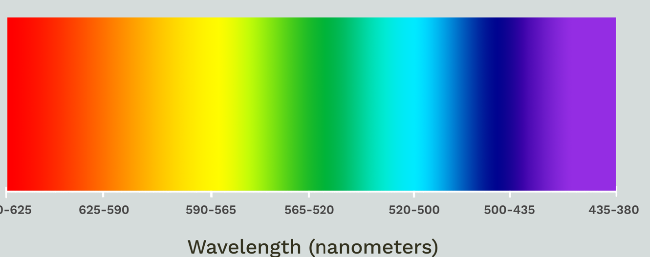
Warm versus Cool Colors https://blog.thepapermillstore.com/color-theory-warm-cool-colors/

