Slide 1
A Brief History of World Religions
In 90 minutes?!?
Rev. Shelli M. Poe, Ph.D.

Slide 2
Introductions
Stephen Prothero, God is Not One

Slide 3
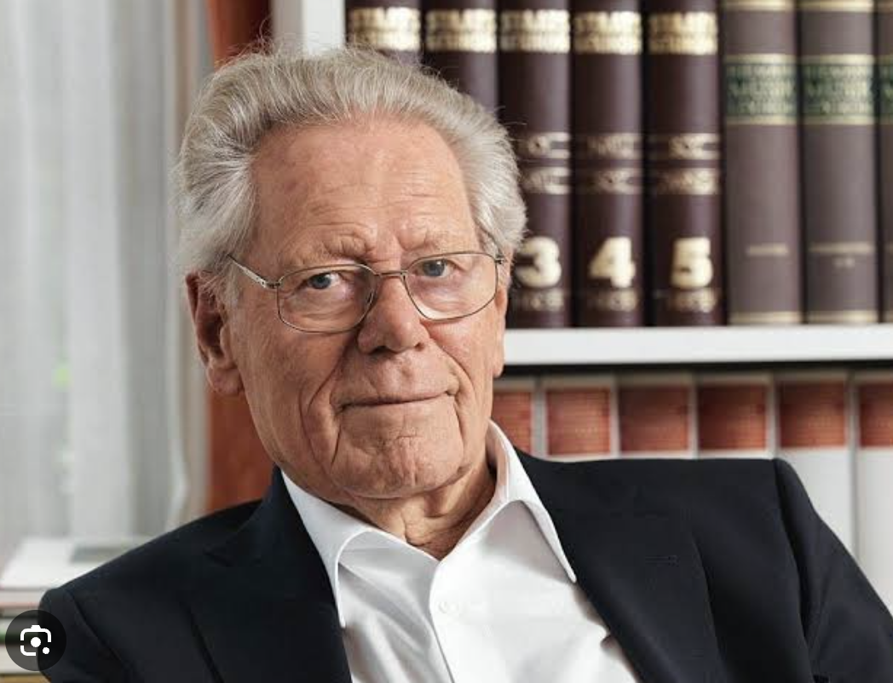
Against leveling out differences
“It would be impossible to find anywhere in the world a sincere Jew, Muslim or atheist who would not regard the assertion that he is an ‘anonymous Christian’ as presumptuous” (6).
-Hans Kung

Slide 4
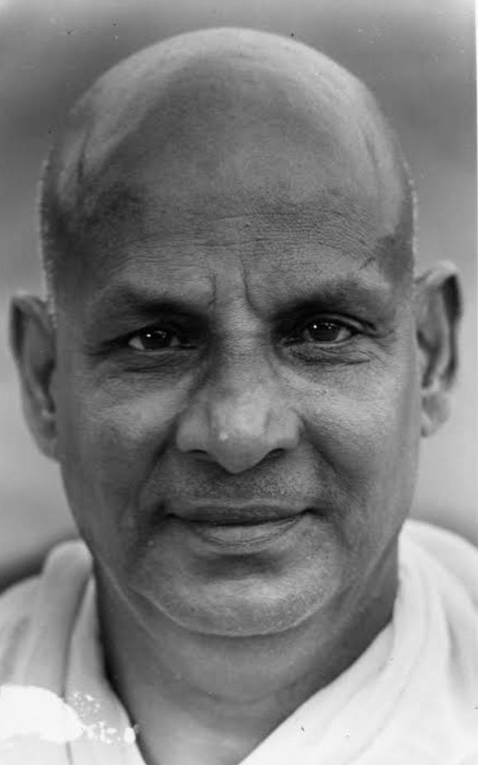
Against leveling out differences
“[We have heard it said that] ‘The fundamentals or essentials of all religions are the same. There is difference only in the non-essentials.’ This is a lovely sentiment but it is dangerous, disrespectful, and untrue” (2).
-Swami Sivananda

Slide 5
Getting a handle on Religious Traditions
Problem
Solution
Technique (to get the solution)
Exemplar (who charts the path to the solution)

Slide 6
Religious Families in SPace

Slide 7
Religious Families over Time

Slide 8
Five Religions
Hinduism
Buddhism
Judaism
Christianity
Islam

Slide 9
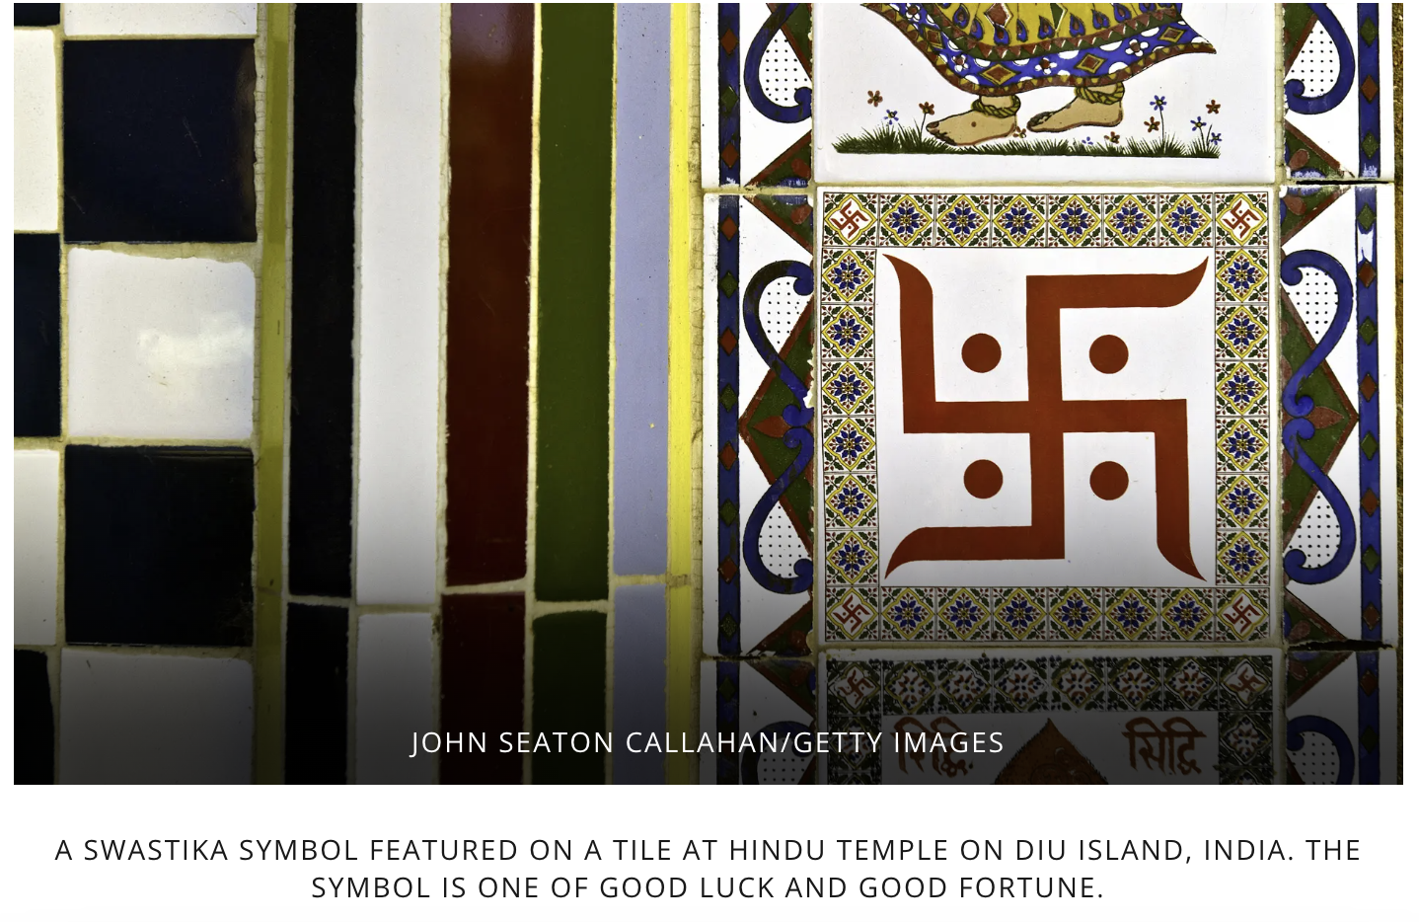
Hinduism
2500-1500 BCE
India
15% of world’s population (3rd largest)

Slide 10
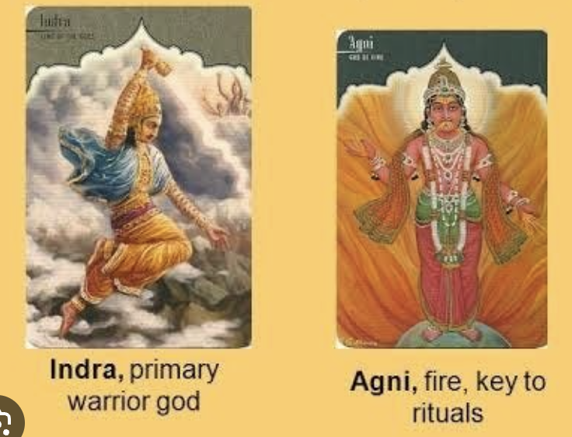
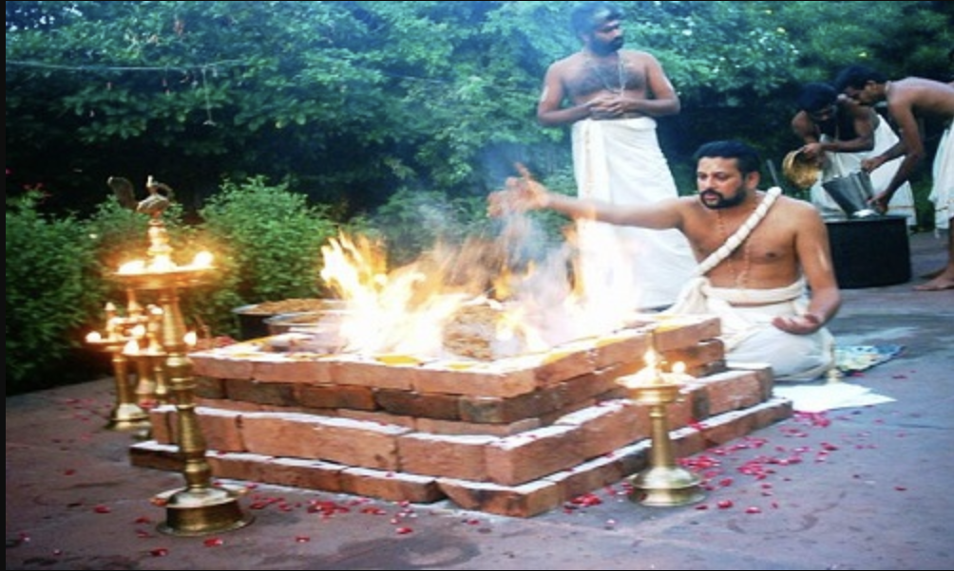
Vedic Religion
Karma yoga path
Sacred Texts: The Vedas:
Rigveda
Yajurveda
Samaveda
Atharvaveda
Key deities: Agni and Indra

Slide 11
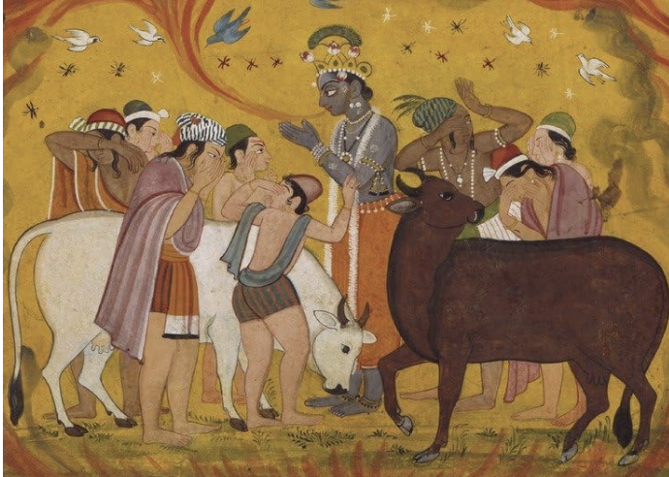
Philosophical Hinduism
Jnana yoga path
Sacred text: The Upanishads
Unchanging eternal soul, trapped in bodies within the cycle of life, death, and rebirth
The essence of humanity is the essence of divinity; they are uncreated, deathless, and immortal.
The goal is to experience the equivalence of the self and the divine.

Slide 12
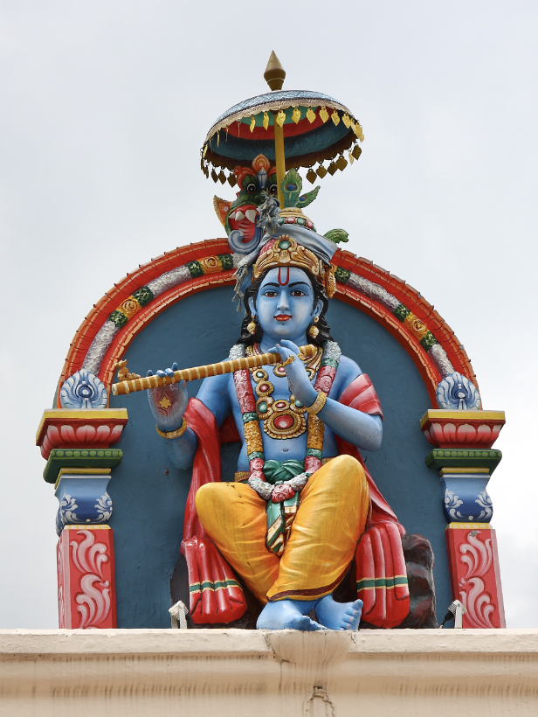
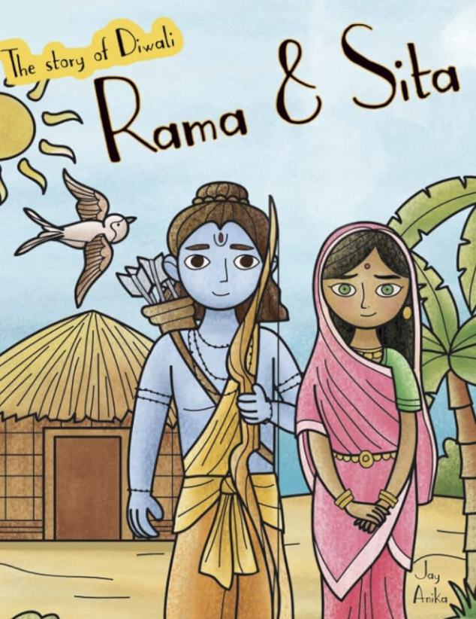
Devotional Hinduism
Bhakti yoga path
Sacred texts: Mahabharata (including Bhagavad Gita), and Ramayana Epics
Key deities: Krishna, Rama and Sita

Slide 13
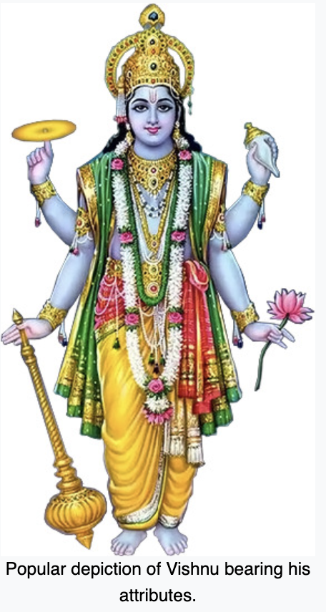
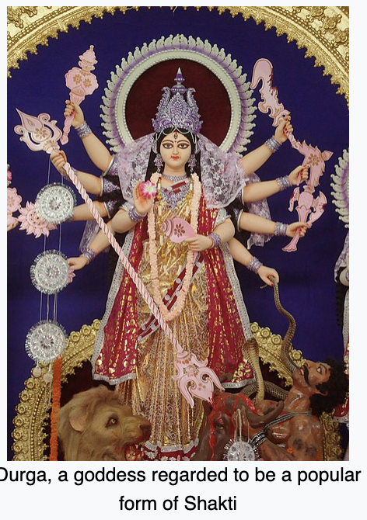
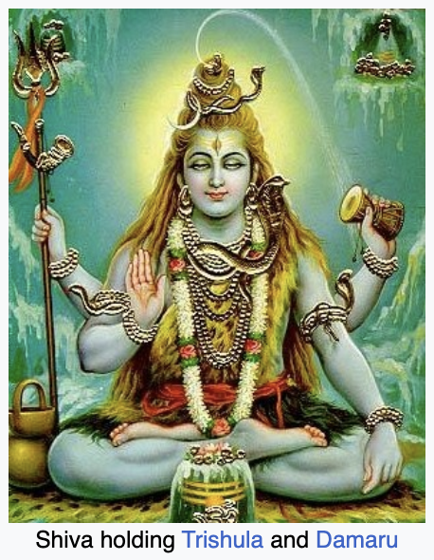
Devotional Hinduism
Vishnu (Vaishnavism)
Shiva (Shaivism;)
Shakti/Mahadevi (Shaktism)

Slide 14
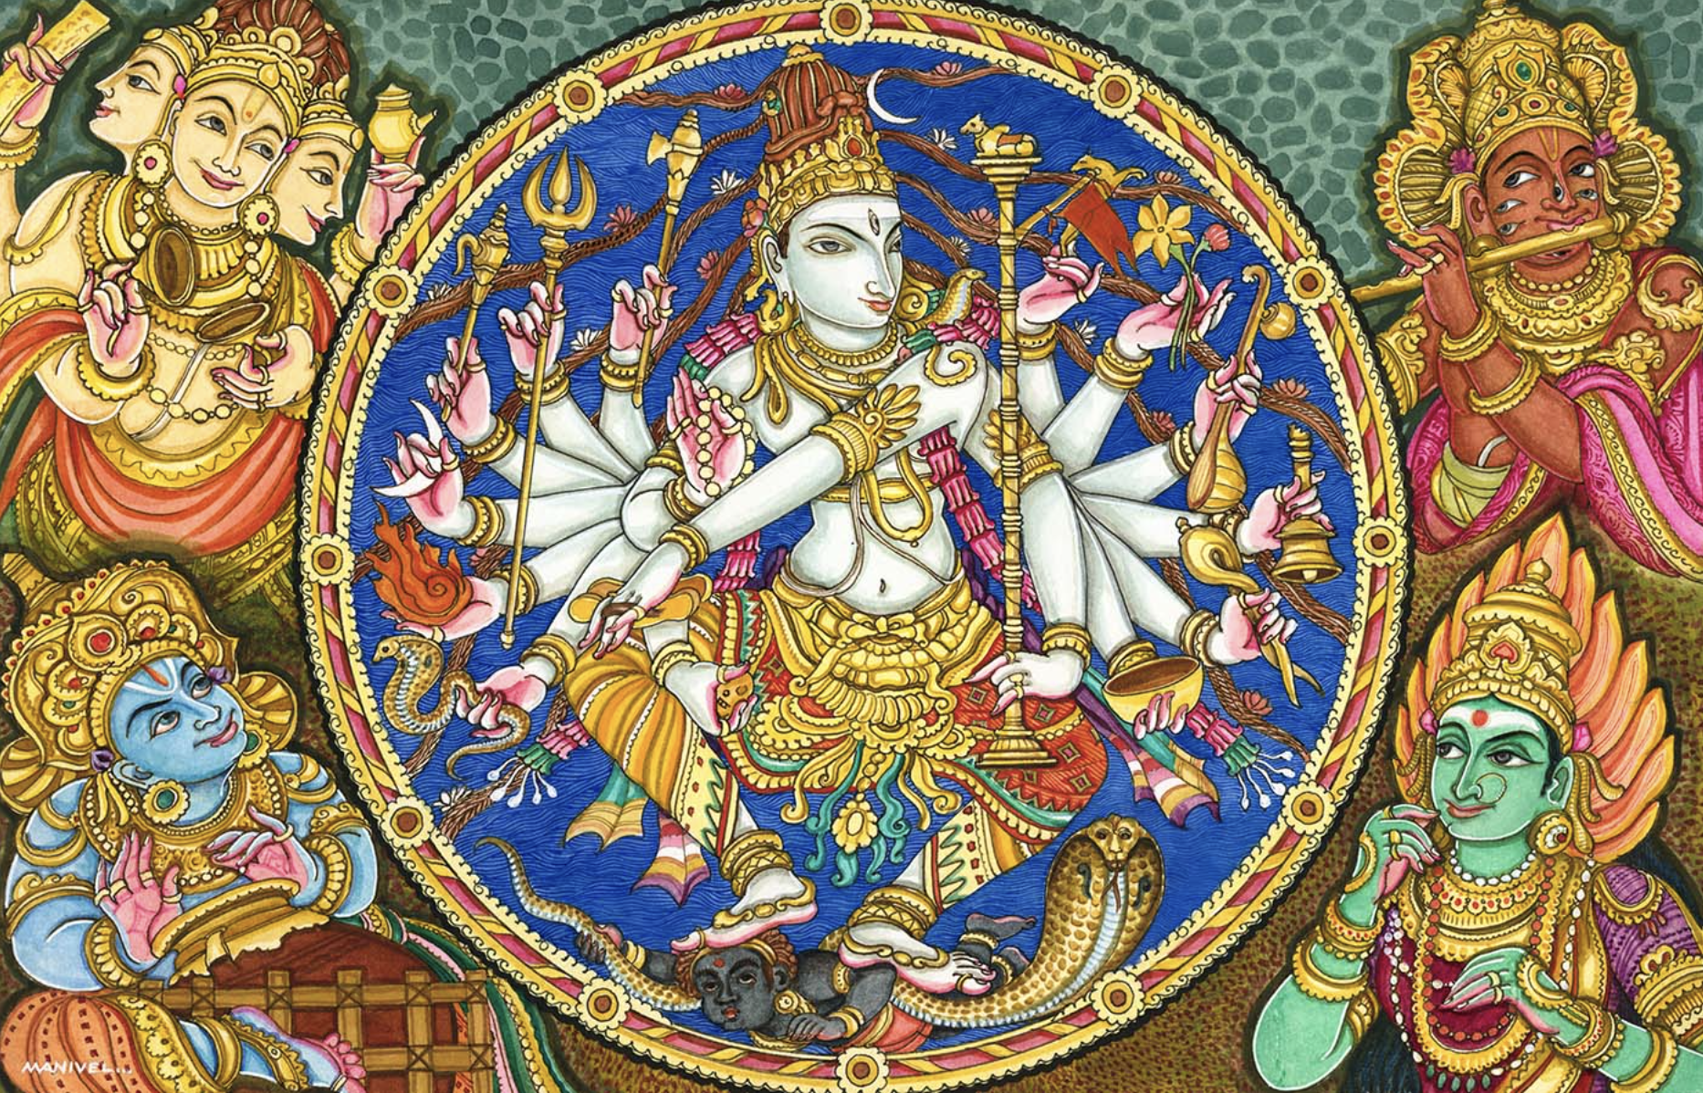
Modern Hinduism
Bending devotional Hinduism toward monotheism
Focus on philosophical Hinduism of the Upanishads

Slide 15
In a nutshell
Problem: Samsara, cycle of life, death, rebirth
Solution: Moksha, spiritual release
Other goals: Kama (sensual pleasure); artha (wealth and power); dharma (duty)
Technique (yogas/disciplines):
karma yoga (action)
Jnana yoga (wisdom)
Bhakti yoga (devotion)
Exemplars: priests (Vedic), mystics (philosophical), yogis and swamis (devotion)

Slide 16
Discussion
What surprises you?
What confuses you?
What do you admire about this religion?
What similarities do you see between this religion and your own tradition?
What differences do you see between this religion and your own tradition?

Slide 17
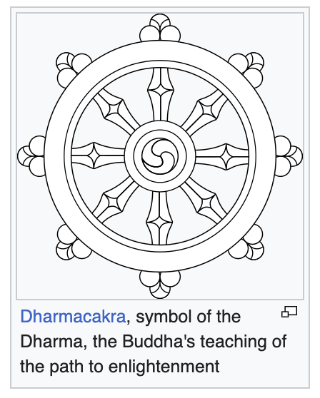
Buddhism
6th c. BCE
Nepal and India to South and East Asia
7% of world’s population; 4th largest

Slide 18
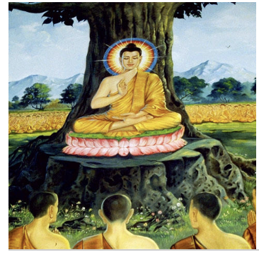
The Buddha
Four Noble Truths:
Life is suffering
Suffering has an origin
Suffering can be eliminated
Eliminate suffering through the 8-fold path:
right understanding
right thought
right speech
right action
right livelihood
right effort
right mindfulness
right concentration

Slide 19
Relation to Hinduism
For Buddhists, the Atman/I/self does not exist.
“I” is a conventional name for five separate parts: matter, sensations, perceptions, thoughts, consciousness.
Buddhists are more explicit about the problem of samsara: life is marked by suffering

Slide 20
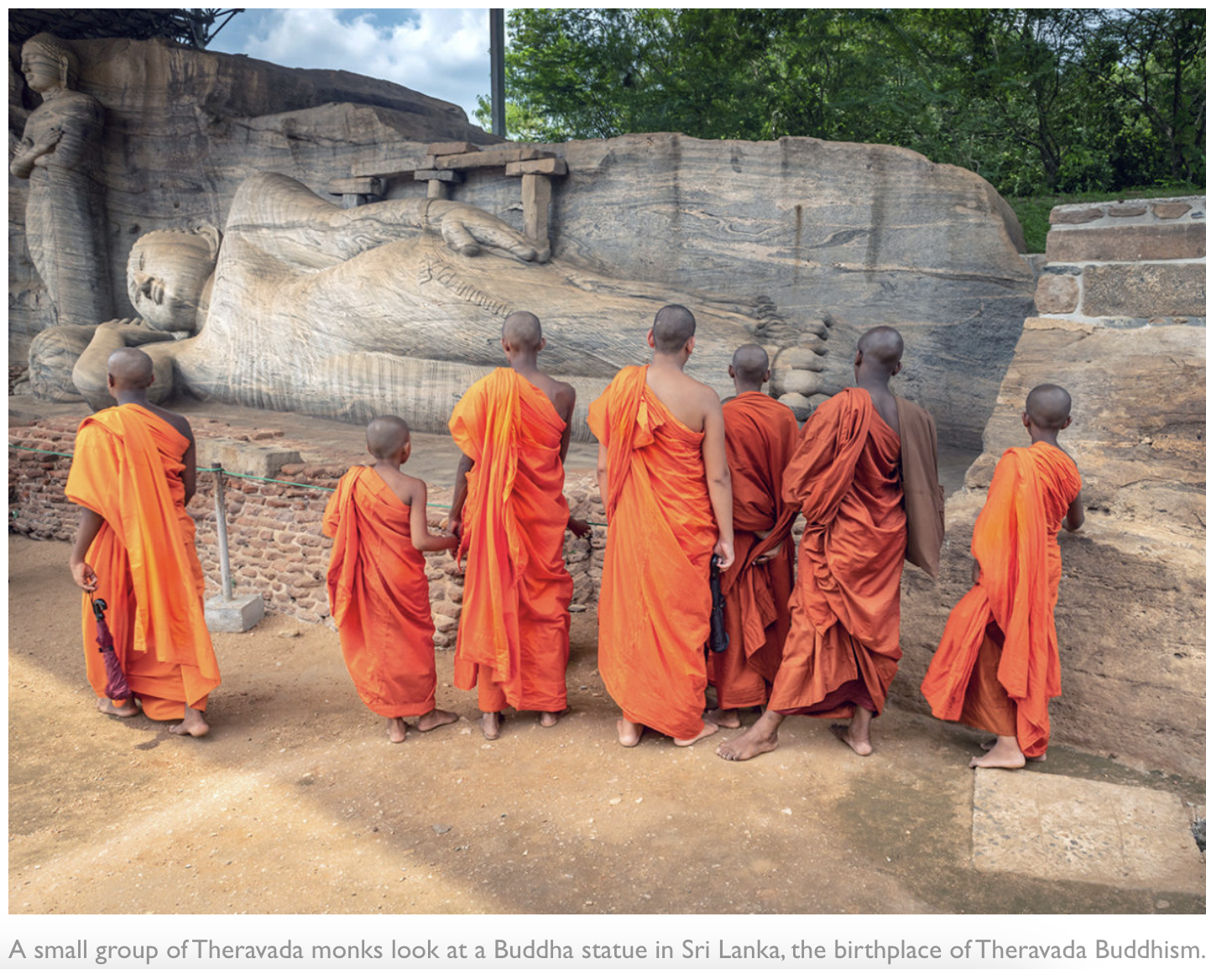
Theravada buddhism
Monastic form
Buddha is a pathfinder
Achieve nirvana through one’s own merit

Slide 21
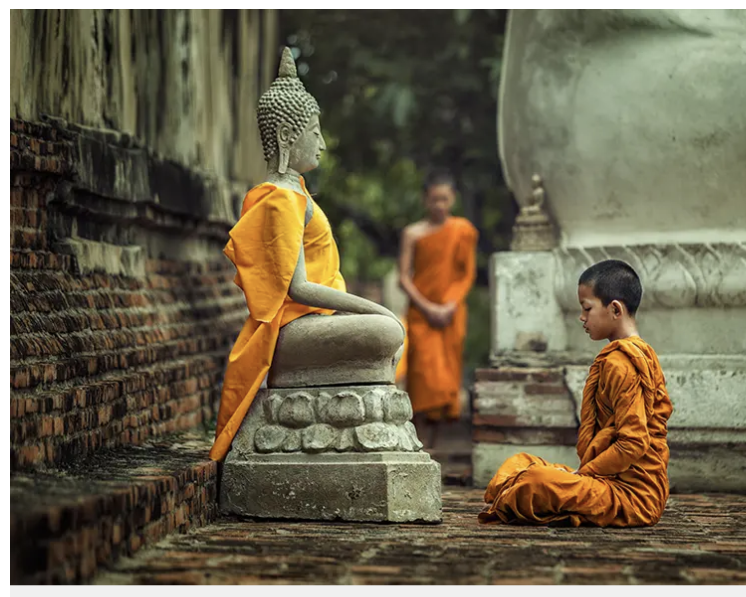
Mahayana Buddhism
Buddha is eternal and omniscient, can answer prayers
Bodhisattvas achieve enlightenment and then use their merit to help others
Devotion to various Buddhas and supramundane figures
Temple worship
Home prayers
Pilgrimages
Funerary rites
E.g. Pure Land, True Pure Land, Lotus Sutra schools (e.g. Soka Gakkai International), Zen (a meditation school)

Slide 22
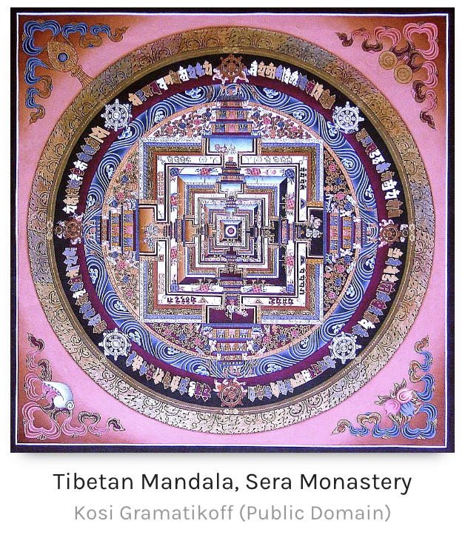
Vajrayana Buddhism
Tibet
Smallest form, developed from Mahayana
Can achieve Buddhahood in one lifetime
Mantras, deities, bodhisattvas, mandalas, mudras (hand gestures), tantric practices

Slide 23
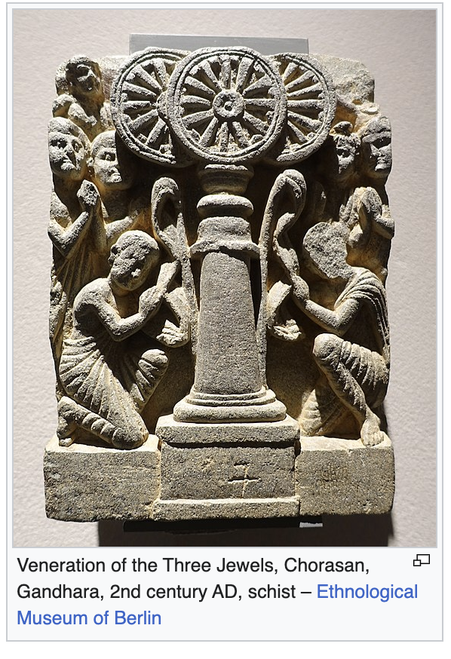
Three Refuges/Jewels
I take refuge in the Buddha
I take refuge in the Dharma (duty to know things as they are)
I take refuge in the Sangha (community).

Slide 24
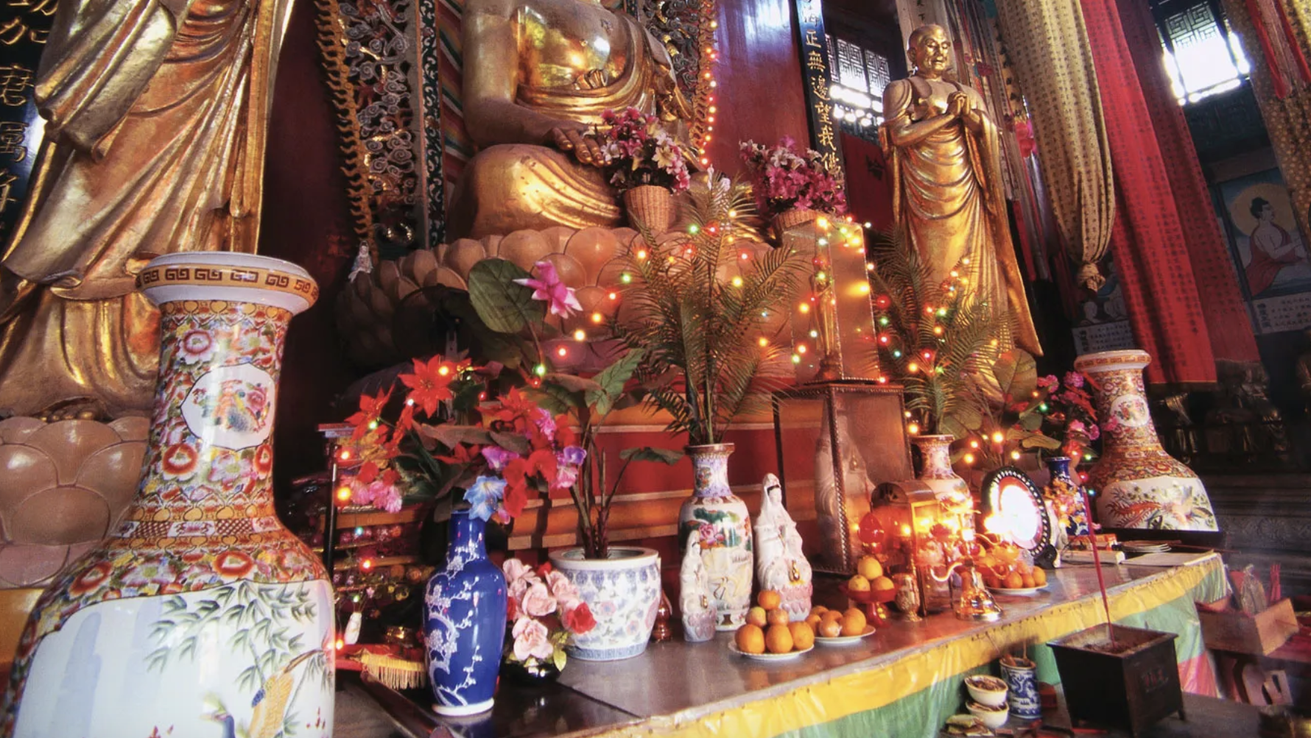
In a nutshell
The problem: Suffering (dukkha).
Suffering is caused by ignorant craving; tendency to mistake changing things for unchanging things; clinging to unchangability.
The solution: Nirvana (extinguishing suffering).
The technique: Eightfold path through the methods offered by various branches of Buddhism.
Exemplars: The Buddha, other Buddhas, Monks, and Bodhisattvas.

Slide 25
Discussion
What surprises you?
What confuses you?
What do you admire about this religion?
What similarities do you see between this religion and your own tradition?
What differences do you see between this religion and your own tradition?

Slide 26
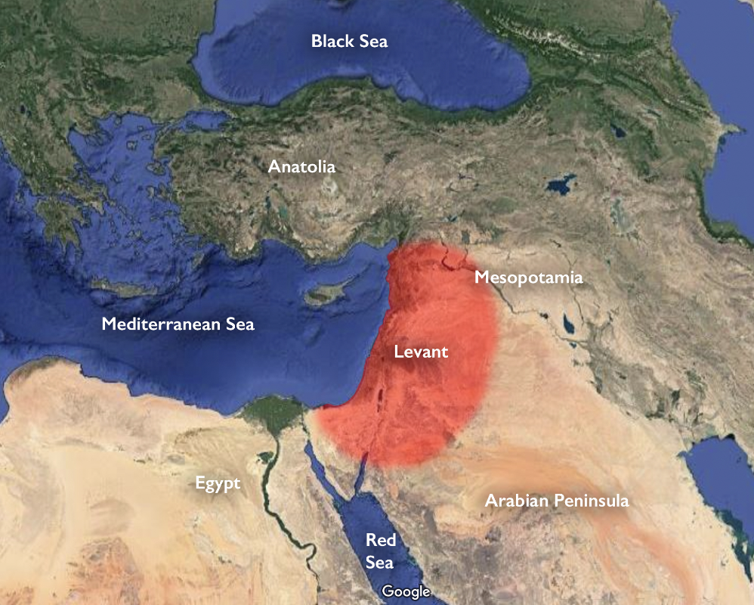
Judaism
Southern Levant of West Asia
2500-1500 BCE
Israel (4.9 million); U.S. (5.2 million); 14 million worldwide

Slide 27
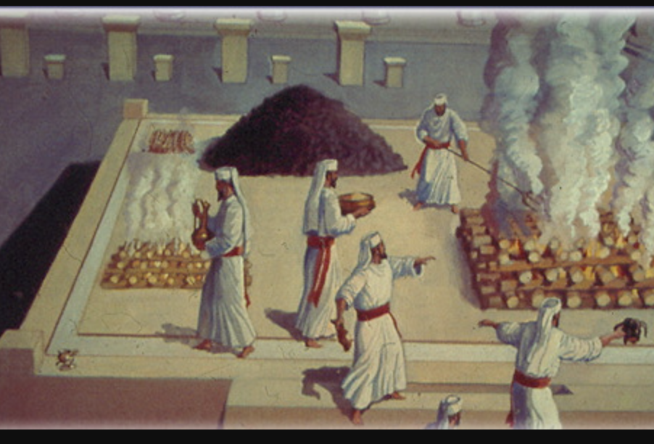
Ancient Judaism
Priestly tradition, sacrifice and devotion
Henotheistic

Slide 28
Battles over the Land
Assyrian conquest: 732 BCE
Babylonian conquest: 586 BCE, 1st Temple destroyed: importance of synagogue, circumcision, monotheism
Persian conquest: 538 BCE, 2nd Temple constructed
Greek conquest: 332 BCE
167 Maccabean revolt
164 recaptured Jerusalem
Roman conquest: 64 CE
70 CE, 2nd Temple destroyed: Jews as a people of the book
132 CE, Bar Kokhba revolt
Arab conquest: 7th century CE
European Christian and Arab Muslim conquests: 11th to 13th centuries CE
Egyptian warriors of Turkish descent ruled: 13th to 16th Centuries
Turkish Ottoman conquest: 16th to 19th centuries
British rule: from 1918
Massacre of Jews by Nazi Germany and its allies/collaborators (Italy, Japan, Hungary, Romania, Bulgaria, Slovakia, Croatia [i.e. Axis powers )
State of Israel founded in 1948

Slide 29
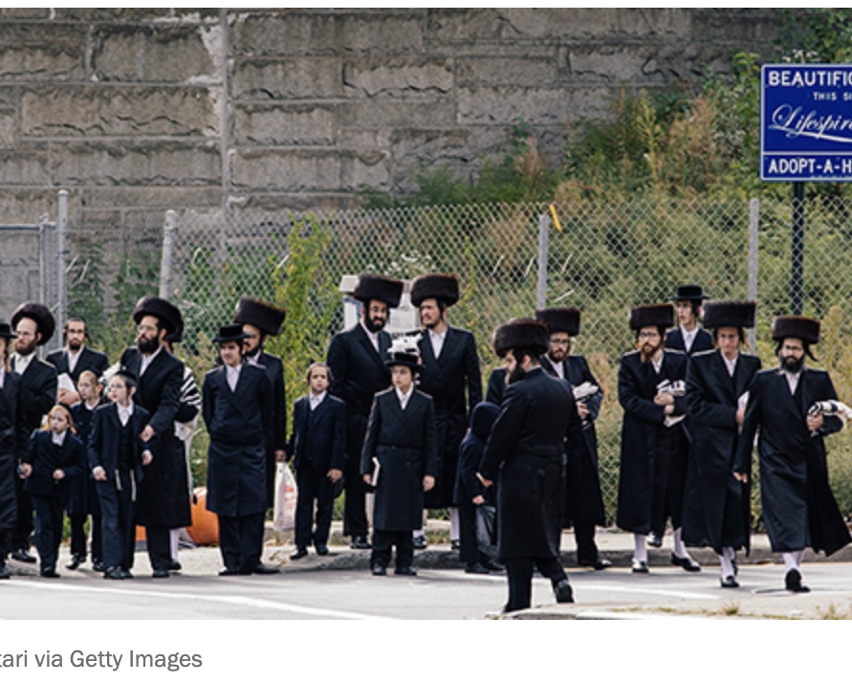
Orthodox Judaism
21% of U.S. Jews who belong to a synagogue
Emphasis: Law, Torah, tradition
Male Rabbis, kosher diets, Hebrew services, yarmulkes, fringes
Men and women segregated in worship
Two types
Modern Orthodox (Yeshiva University in NY)
Hasidism: Ultra-orthodox, began in 18th c.

Slide 30
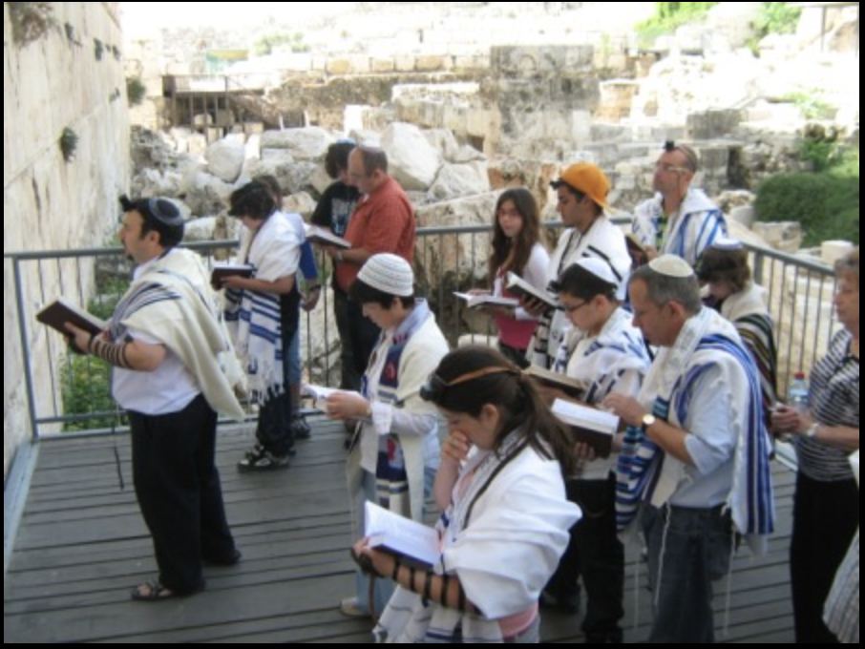
Conservative Judaism
33% of U.S. Jews
Focus on tradition, worship in Hebrew, ritual commands, law
Open to advances in modern thought
Women and LGBTQ people can be ordained
Origin: 1886 NYC, Jewish Theological Seminary

Slide 31
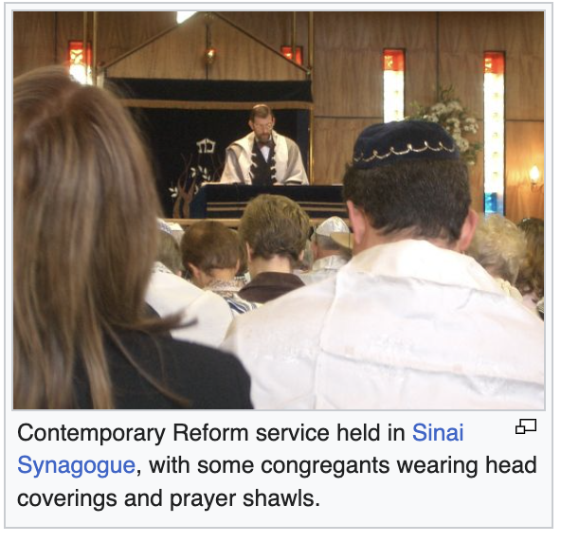
Reform Judaism
39% of Jews in U.S.
18th century origins, now represented by Hebrew Union College
Focus on ethics, social justice
Sermons and prayers in the vernacular
Women and men sit together

Slide 32
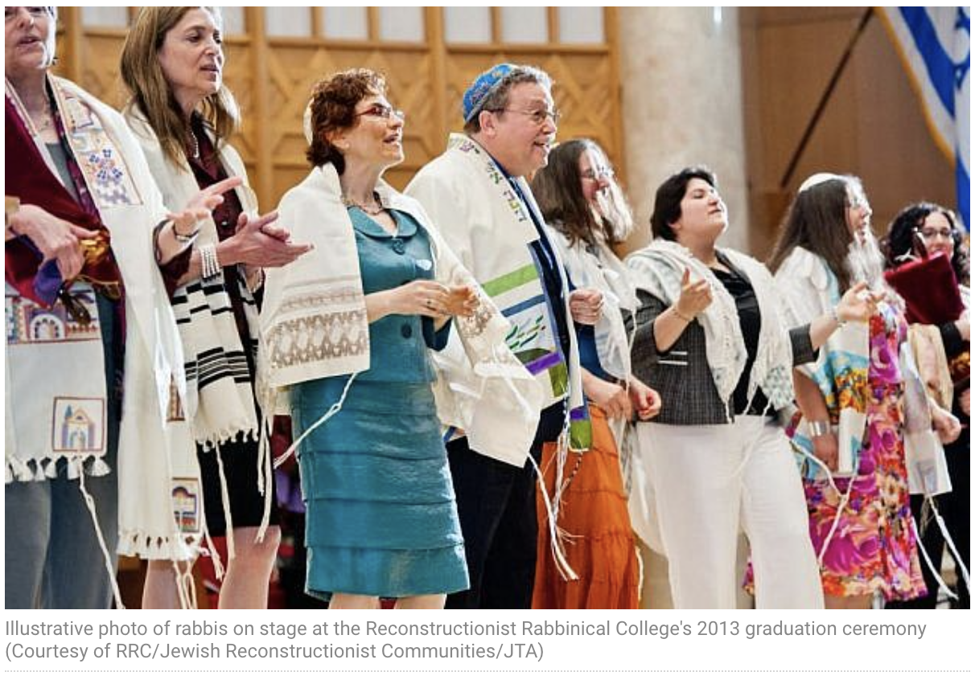
Reconstructionist Judaism
Origins in Conservative Judaism, American branch: Mordecai Kaplan (19th c)
Reconstructionist Rabbinical College, Philadelphia 1968
Rejects Jews as chosen people
God is highest expression of human ethical ideals
Commands are folkways, not law
Hebrew worship, observe holy days

Slide 33
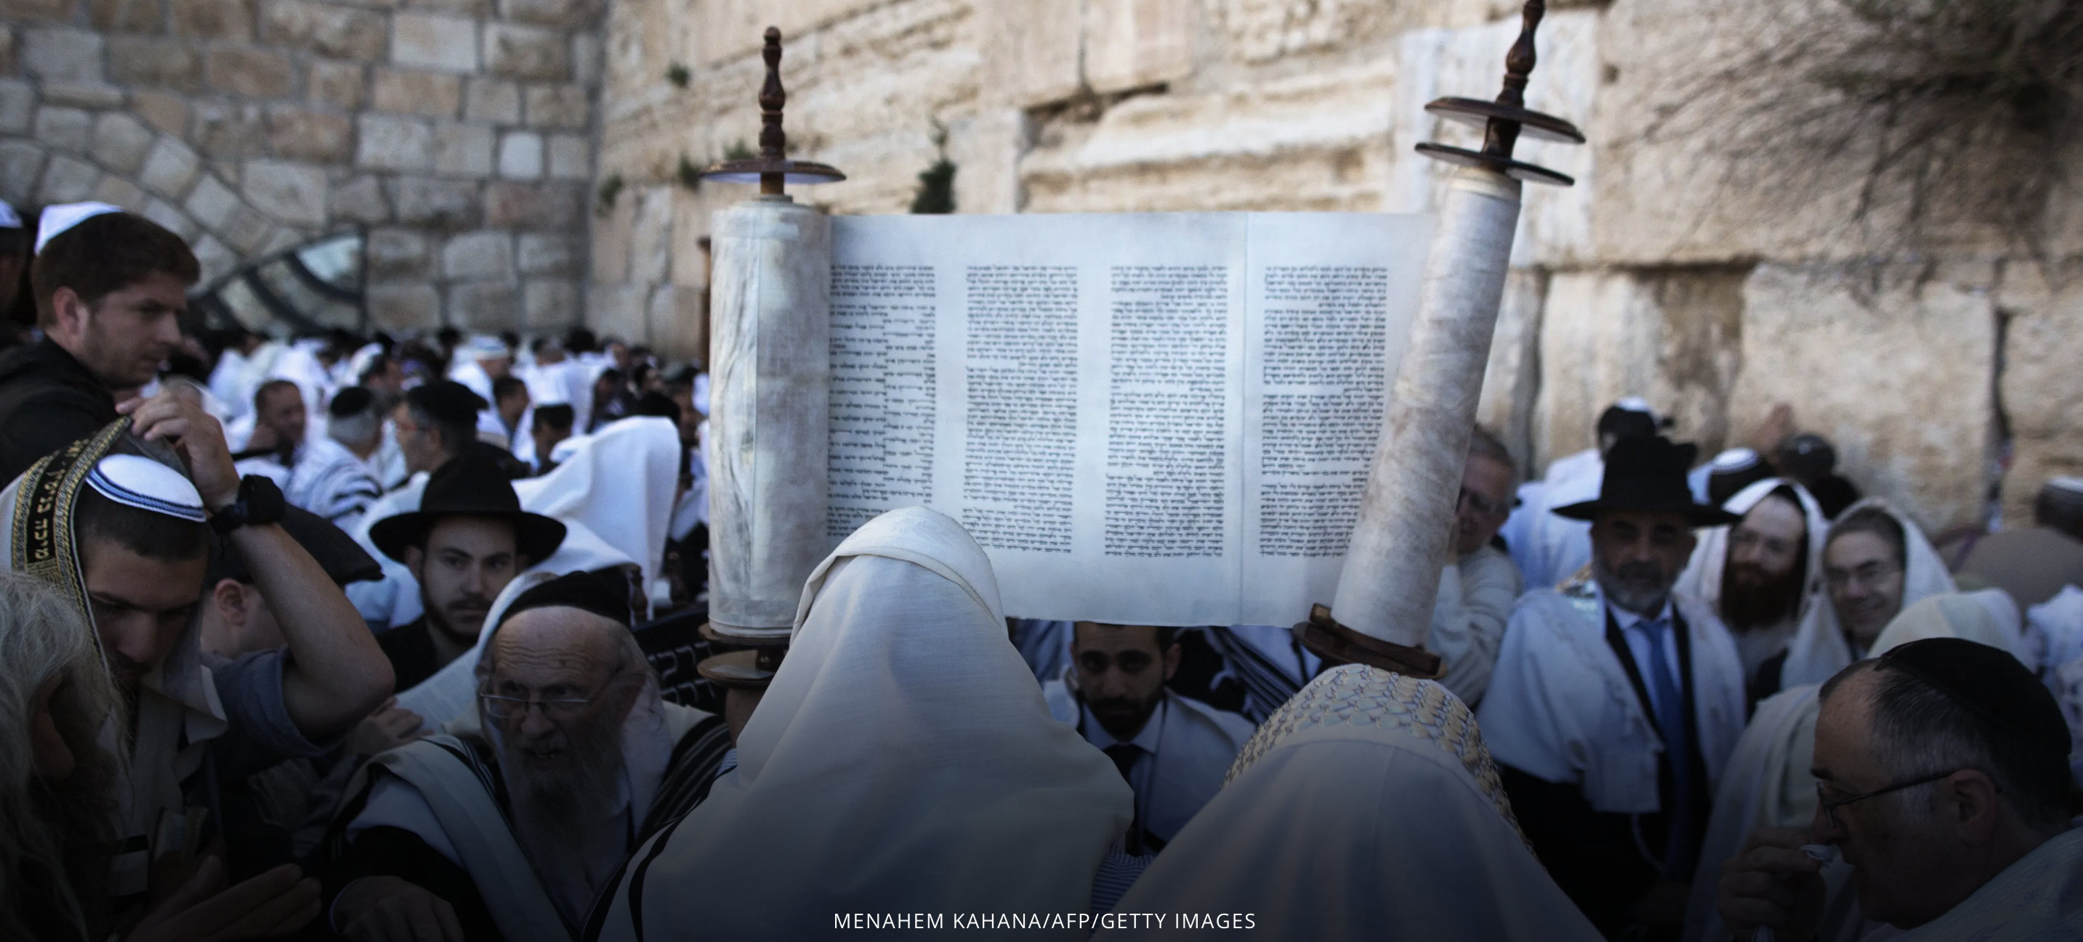
In a nutshell
Problem: Disobedience and forgetfulness of the one God
Solution: Obedience of commands and remembrance of God
Technique: Learn Torah and Talmud, tell the story, follow the law
Exemplars: Rabbis

Slide 34
Discussion
What surprises you?
What confuses you?
What do you admire about this religion?
What similarities do you see between this religion and your own tradition?
What differences do you see between this religion and your own tradition?

Slide 35
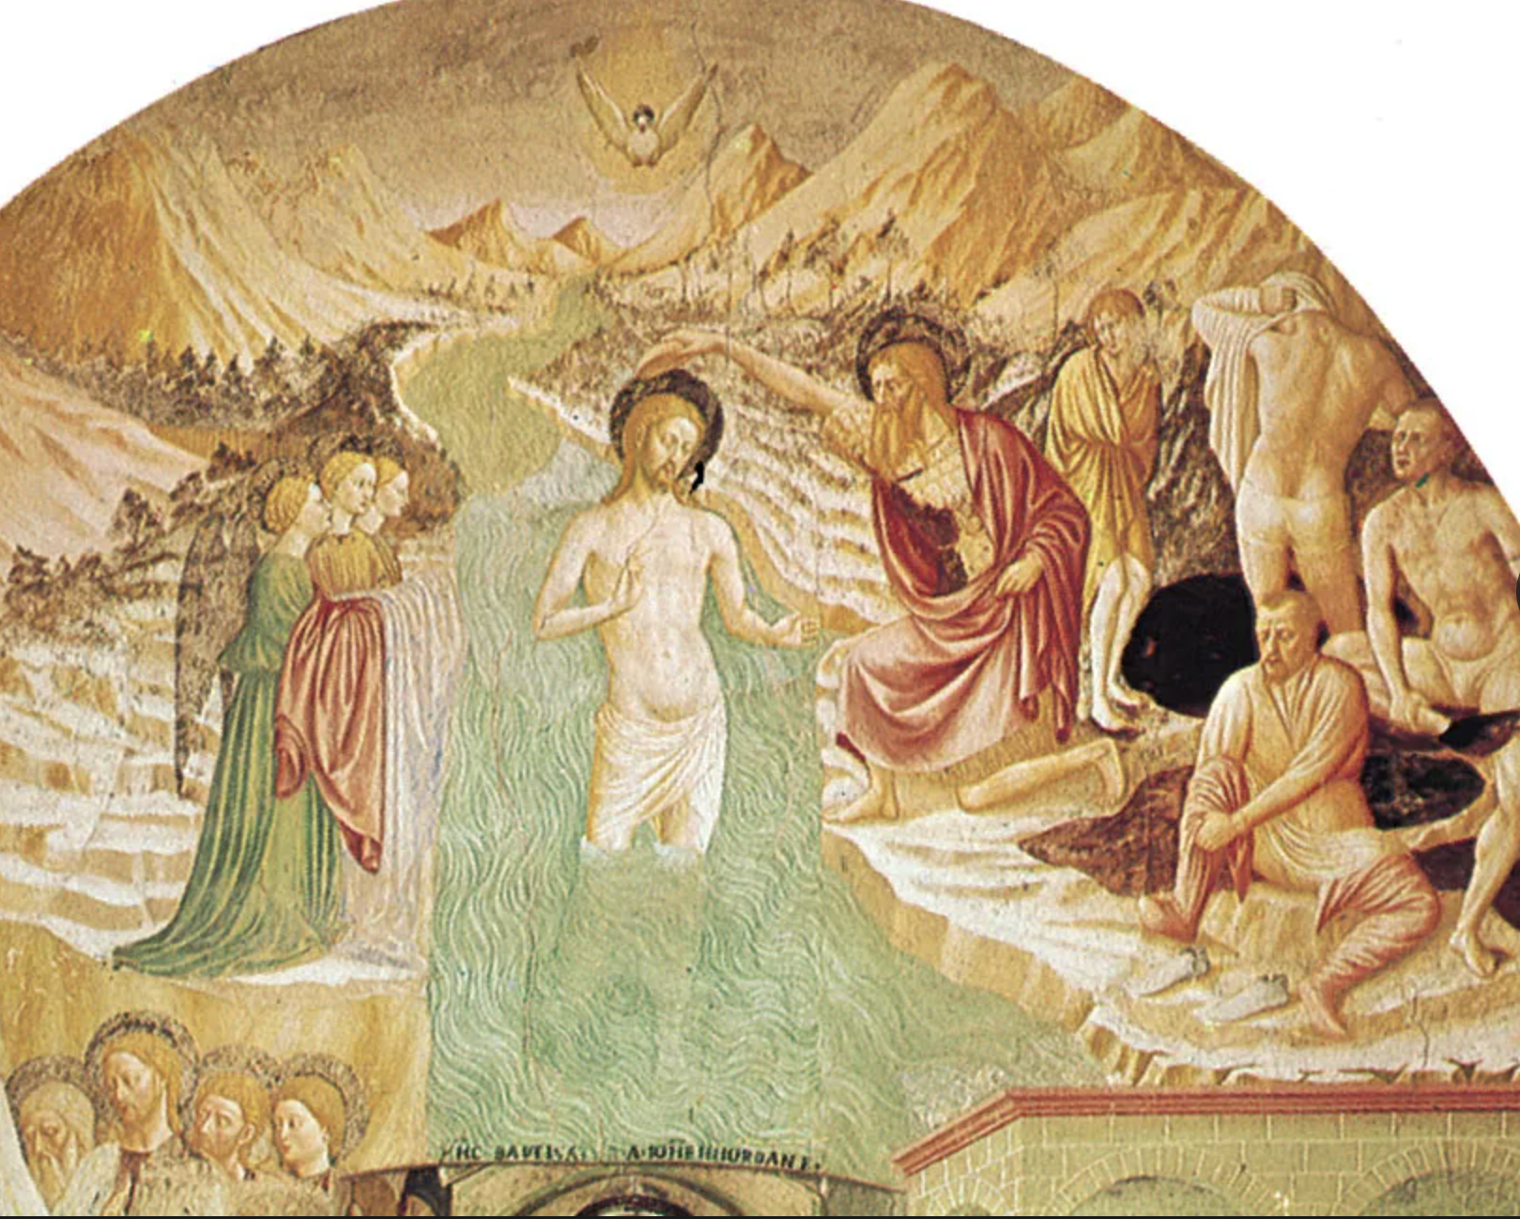
Christianity
1st century CE
Levant, Mediterranean, North Africa
33% of world population

Slide 36
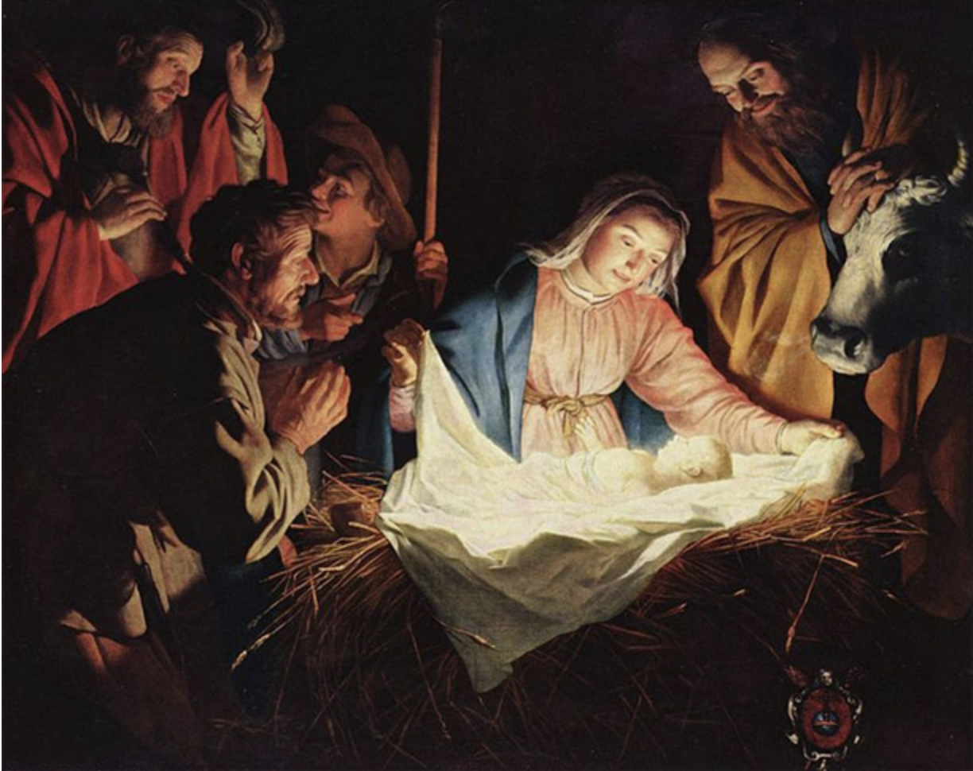
Jesus of nazareth
1st century Jew, claimed he was the Messiah/anointed one bringing good news to the poor and oppressed (Jews under repressive Greco-Roman rule)
Preached/taught and formed a community around himself:
Love of God and neighbor
Social justice
Forgiveness/non-judgment

Slide 37
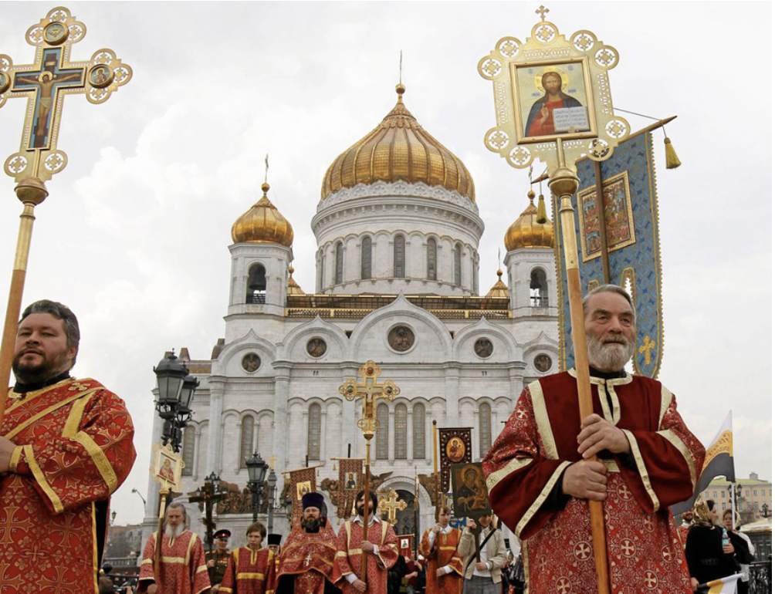
Orthodox Church
Eastern regions of Mediterranean, Europe, Middle East
Origins in Greek language
Broke from previously united Catholic church in 1054
Many patriarchs of various regions

Slide 38
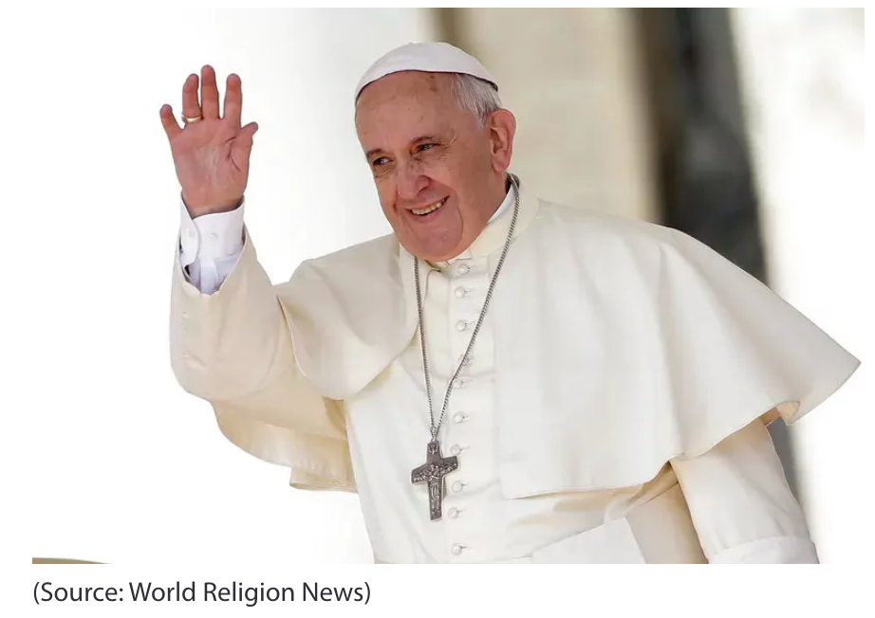
Roman Catholic Church
Western regions of Mediterranean and Europe, and North Africa
Origins in Latin language
One primary leader (the pope) and several under him in hierarchy

Slide 39
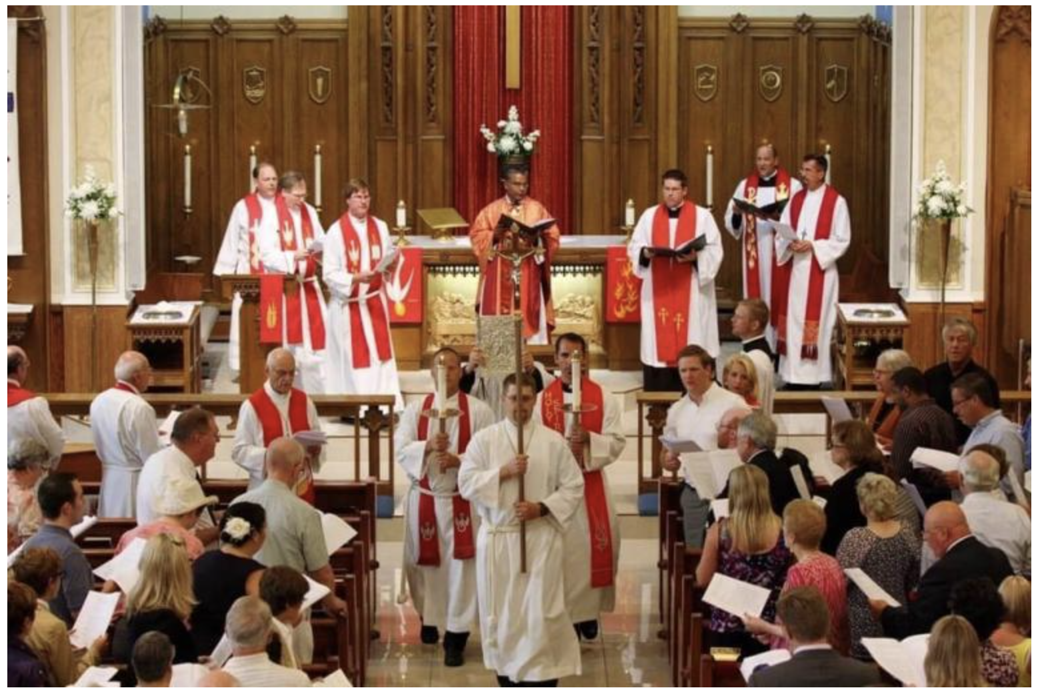
Protestant Churches
Originated in reform of Roman Catholic Church, 16th c.
Allegations of economic exploitation of poor people
Emphasis on scripture, faith, grace
No primary leader; several denominations
Lutheran
Reformed: Presbyterian, United Church of Christ
Anglican/Episcopal, Wesleyan/Methodist, Pentecostal
Free churches: Baptist, Quaker, Anabaptist, Mennonite, etc.

Slide 40
Distinctive beliefs and practices
Trinity
God is one
The one God has three external distinctions: creator, redeemer, sustainer
The one God has three internal distinctions: Father, Son, Holy Spirit; or Love, Wisdom, Power
Christ as fully human and divinely indwelt (incarnation)
Practices:
Baptism, confirmation: entrance into community
Communion: commemoration of Jesus’ last supper at Passover with disciples

Slide 41
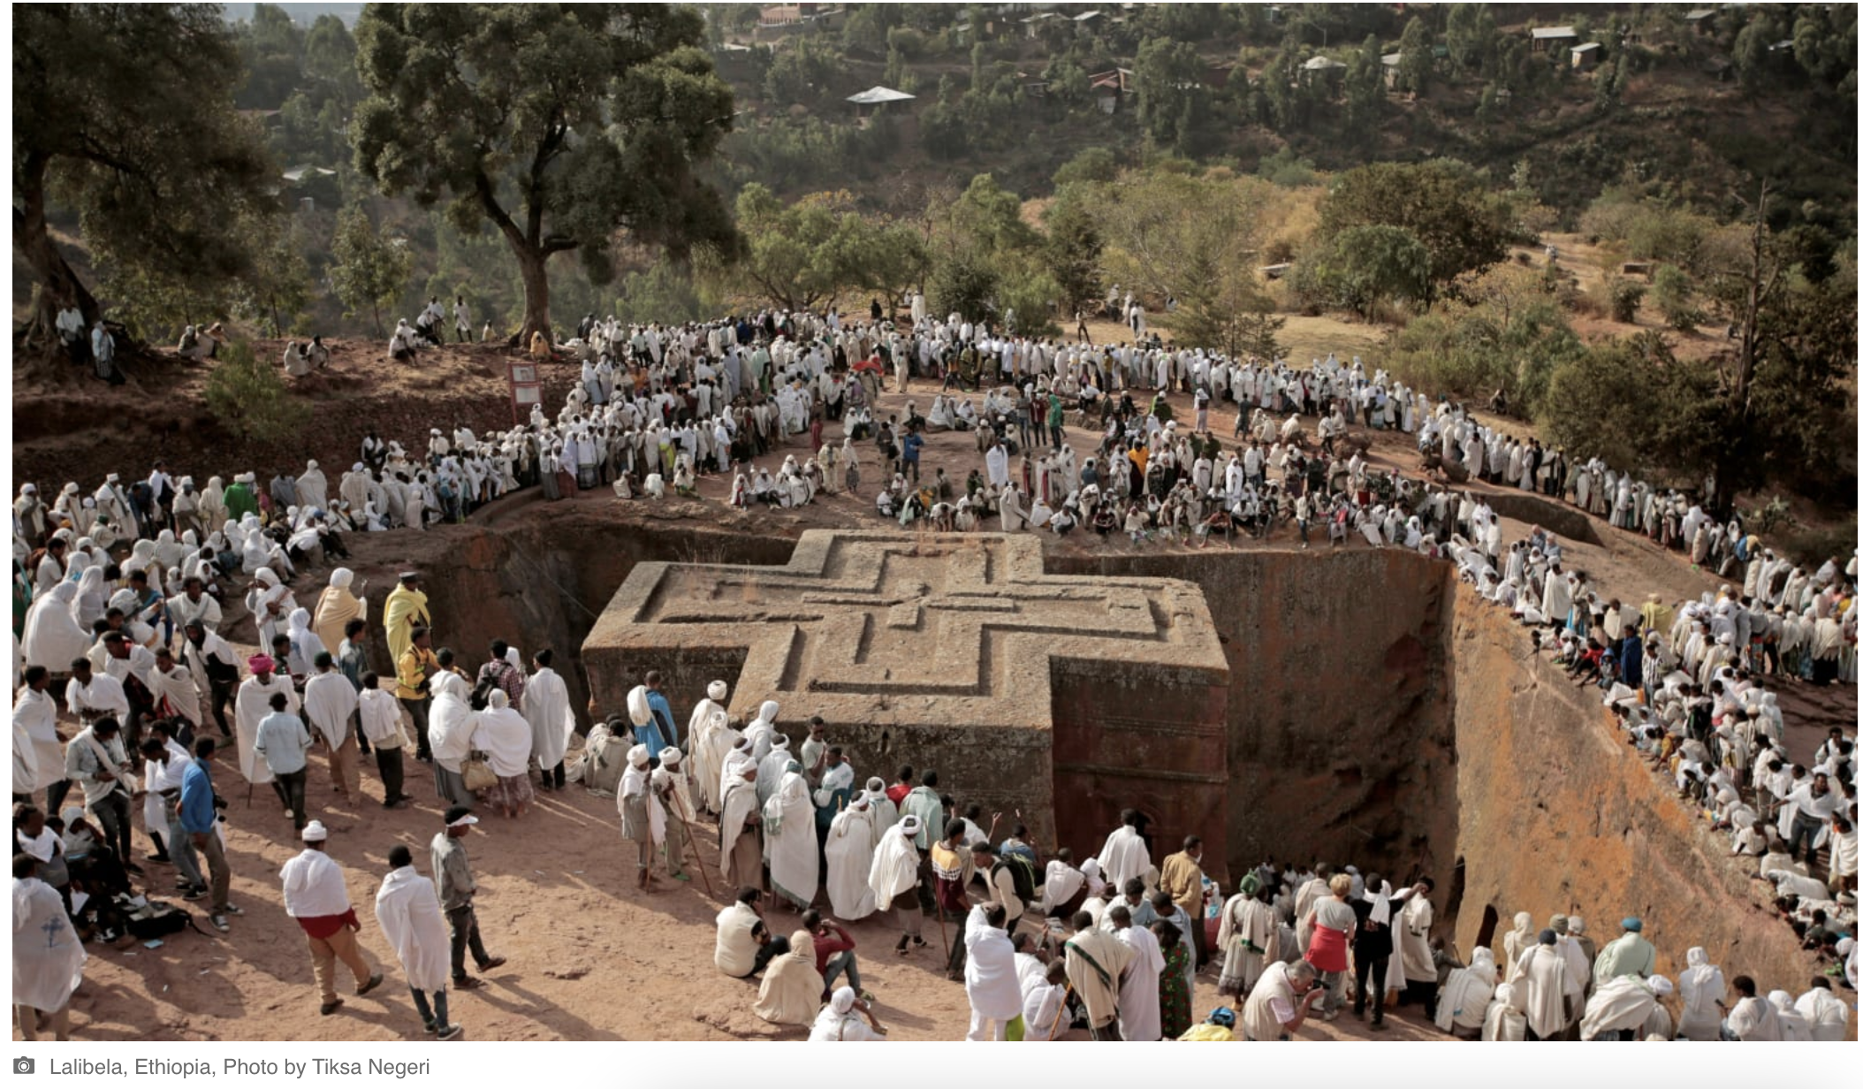
In a nutshell
Problem: Humans are separated from God and others
Solution: Union with God and others through Jesus of Nazareth
Technique:
Conservative: Accept/trust that Jesus’s death unites people with God
Progressive: Join a community in which the Spirit of Jesus is alive and be transformed by that Spirit
Exemplars: Jesus, saints

Slide 42
Discussion
What surprises you?
What confuses you?
What do you admire about this religion?
What similarities do you see between this religion and your own tradition?
What differences do you see between this religion and your own tradition?

Slide 43
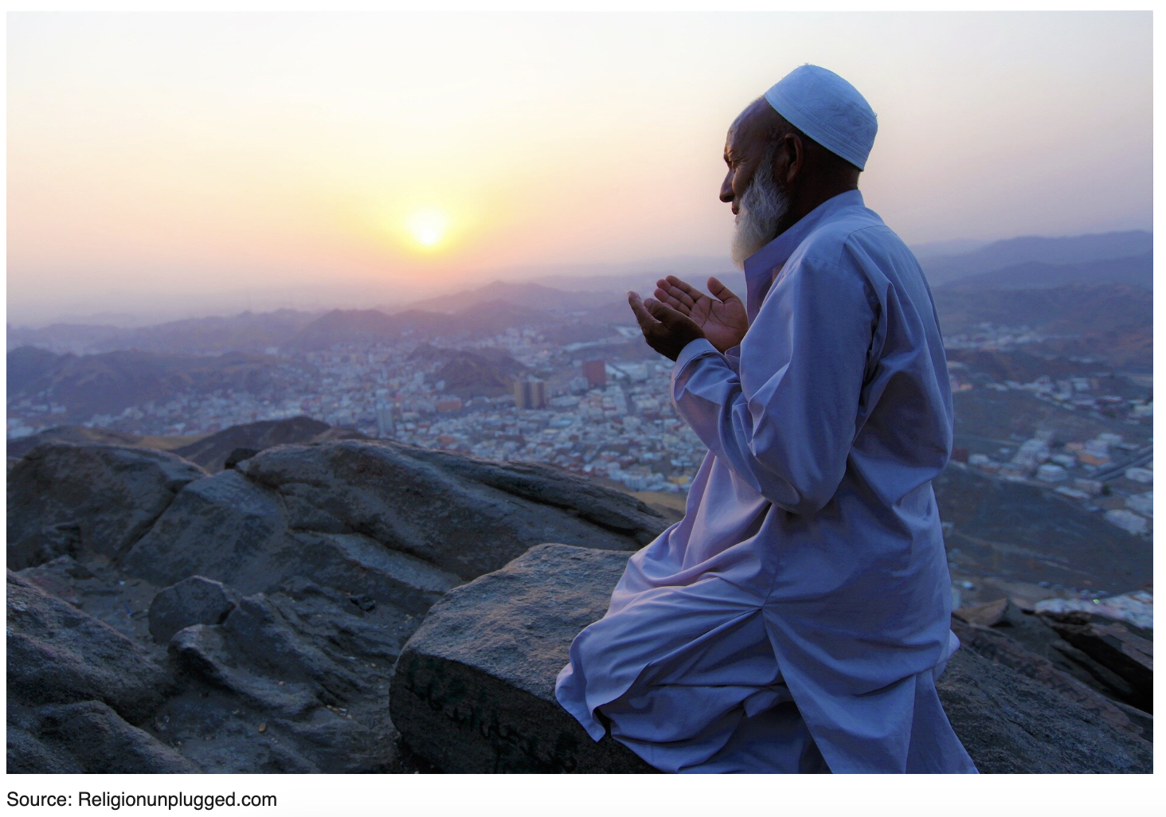
Islam
7th century CE
Mecca, Medina (Saudi Arabia)
1/5th of world population (2nd largest)

Slide 44
Muhammad
570-632 CE, born in Mecca
At 40 years old as a merchant, Angel Gabriel commands him to recite (610-632)
Religious, political, and military leader
Community (umma) founded in 622, fled to Medina
Torah and Gospels were revealed by Allah but were corrupted; Qur’an is perfectly preserved
Qur’an in Islam is analogous to Jesus in Christianity: Word of God in the world recited to companions

Slide 45
Relation to Judaism and Christianity
Torah and gospels were revealed by Allah through prophets, but they were corrupted
Only the Quran is perfectly preserved

Slide 46
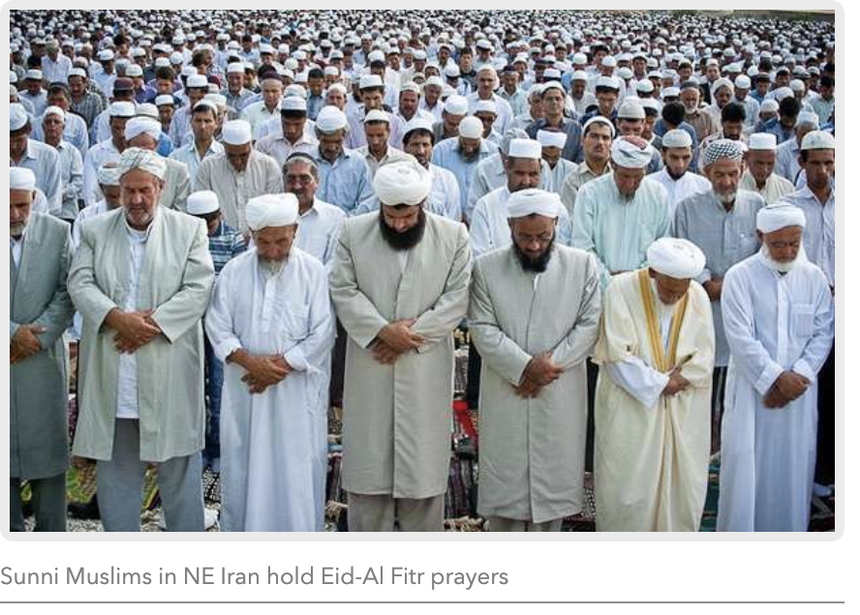
Sunni
Sunna = tradition
85% of Muslims
See Muhammad’s father-in-law, Abu Bakr, as Muhammad’s successor
Decentralize religious authority into the community as a whole
Invest social and political authority in a series of caliphs

Slide 47
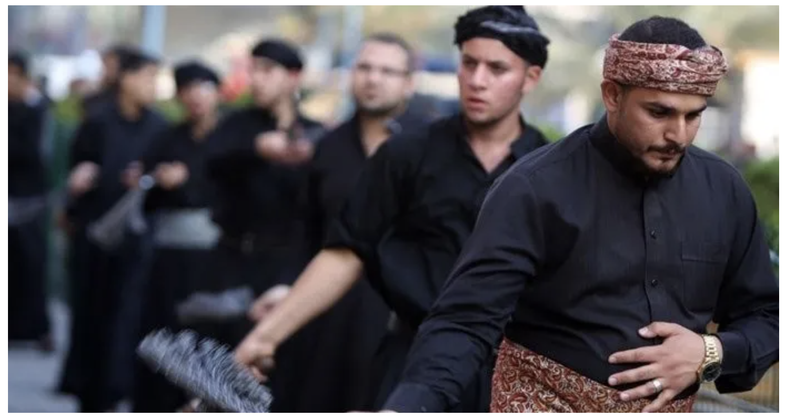
Shia
15% of Muslims
See Muhammad’s son-in-law, Ali, as Muhammad’s successor
Centralize religious, social, and political authority in the Imam (must descend from Muhammad, sinless, infallible)

Slide 48
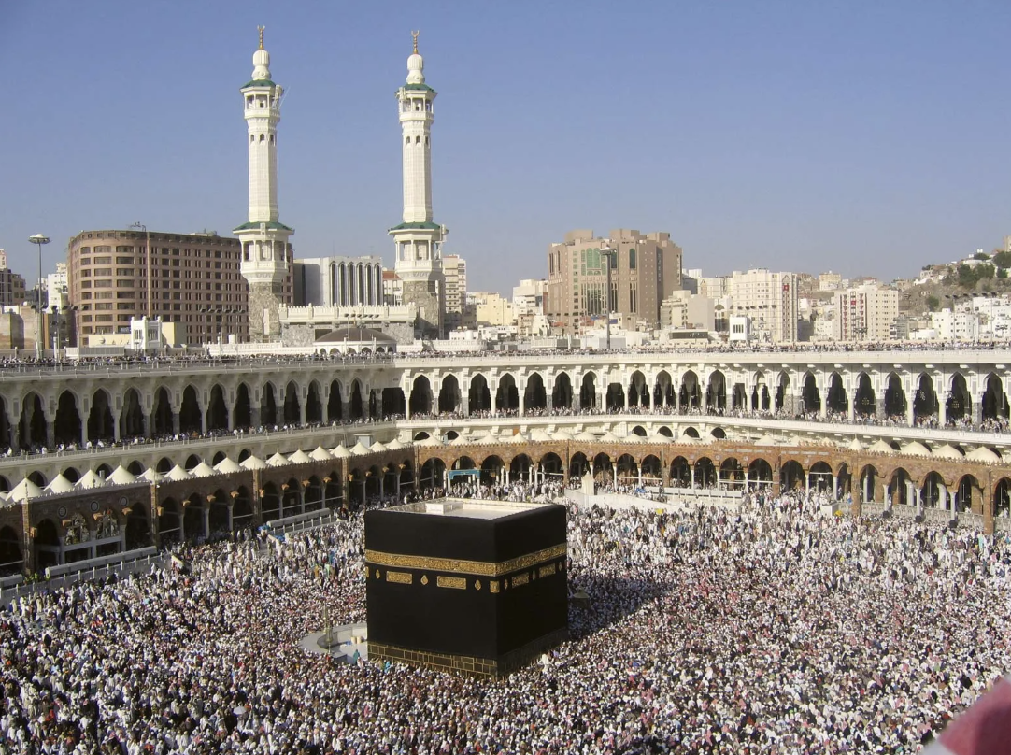
Five pillars of Islam
Shahadah: “There is no god but God and Muhammad is the messenger of God”
Salat: Prayer
Zakat: Charity
Sawm: Fasting during Ramadan
Hajj: Pilgrimage to Mecca
Allah
Divine Oneness
Divine transcendence (can’t incarnate)

Slide 49
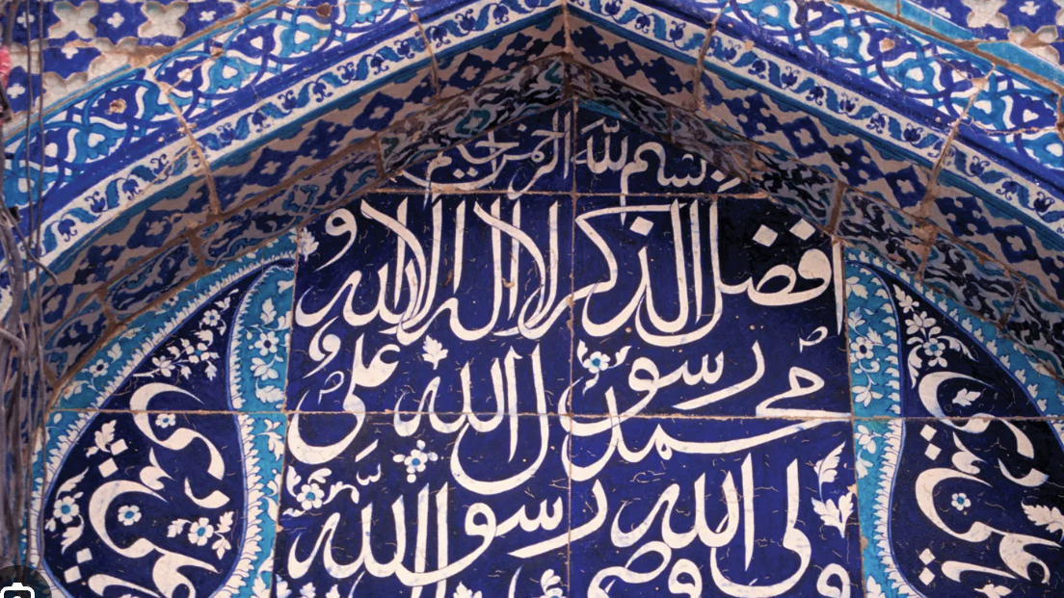
In a nutshell
Problem: Pride, forgetting your true nature
Solution: Submit to Allah, humility
Technique: 5 Pillars
Exemplars: Muhammad, Islam

Slide 50
Discussion
What surprises you?
What confuses you?
What do you admire about this religion?
What similarities do you see between this religion and your own tradition?
What differences do you see between this religion and your own tradition?

Slide 51
 | Hinduism | Buddhism | Judaism | Christianity | Islam
When? | 2500-1500 BCE | 6th c. BCE | 2500-1500 BCE | 1st c. CE | 7th c. CE
Where? | India | South and East Asia | Southern Levant | Southern Levant | Saudi Arabia
How Many? | 15% | 7% | 0.2% | 31% | 23%
Polytheism to Monotheism | Incorporates polytheism, functional atheism, and monotheism | Incorporates polytheism, atheism, agnosticism. | Henotheistic until 6th c. BCE; incorporates monotheism, atheism, and agnosticism | Incorporates soft monotheism (distinctions within the one God) | Incorporates strict monotheism
Relations between Religions |  | Arises from Hinduism; Disagrees with Hinduism over the existence of the self, emphasizes suffering as the problem in samsara | Influenced by Zoroastrianism (Persian/Iran, monotheistic, 6th c. BCE) | Arises from Judaism; Disagrees with Judaism about Jesus as the Messiah, relevance of the law, incarnation and divine Triunity | Arises from Judaism and Christianity; Disagrees with them about the accuracy of scriptures; Disagrees with Christianity about incarnation and divine Triunity
Problem | Samsara: Life, death, rebirth | Dukkha: Suffering caused by ignorant craving | Disobedience and forgetfulness of God | Separation from God and others | Pride
Solution | Moksha: Release from cycle | Nirvana: Extinguishing suffering | Obey and remember | Union with God and others through Christ | Submission
Technique | Ritual Actions, Wisdom, or Devotion | Monasticism, Devotion, or Meditation | Study, observe commandments, observe holy days, tell the story | Devotion, study, communal life, social action | Confession, Prayer, Charity, Fasting, Pilgrimage
Exemplars | Priests, Mystics, Yogis, Swamis | Monks, the Buddha, other Buddhas, bodhisattvas | Rabbis | Jesus, saints | Muhammad, Imams

Slide 52
Reflection
How are these religions similar?
How are these religions dissimilar?
What surprises you about these comparisons?
What questions do the comparisons raise?

Slide 53
Thank you!
All are invited to Little River UCC!

