Slide 1
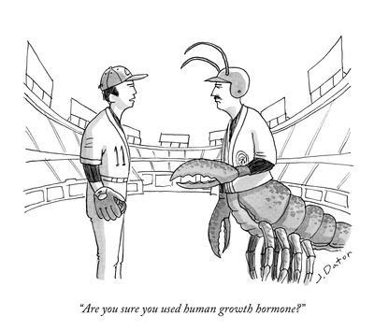
Diabetes (Part 2!)
And Other Endocrine Oddities
Joe Bean, M.D.
LLI Summer 2025
(Images are from a variety of sources and used only for educational purposes!)

Slide 2
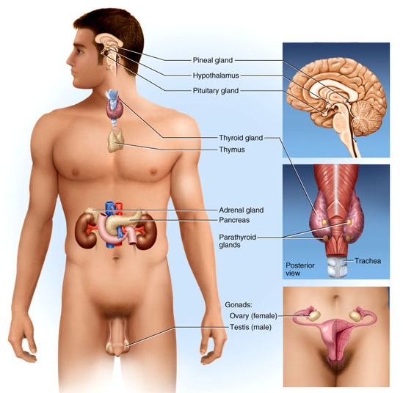
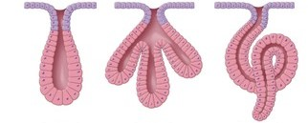
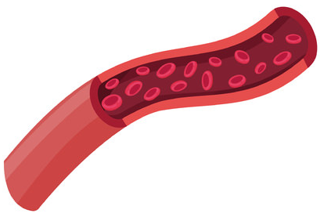
What Is the Endocrine System?
Glands – groups of cells that release a product
Exocrine vs. Endocrine
Release hormones, chemicals that travel in the blood
Endocrine cell
Target cell
Receptor

Slide 3
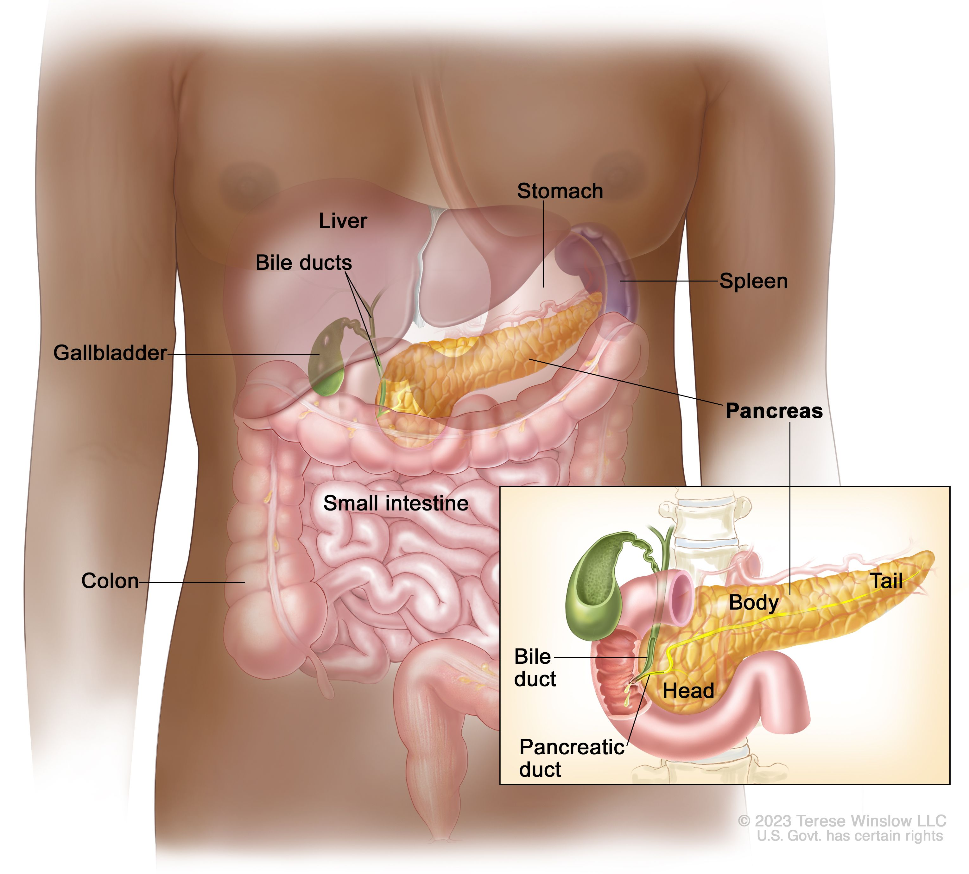
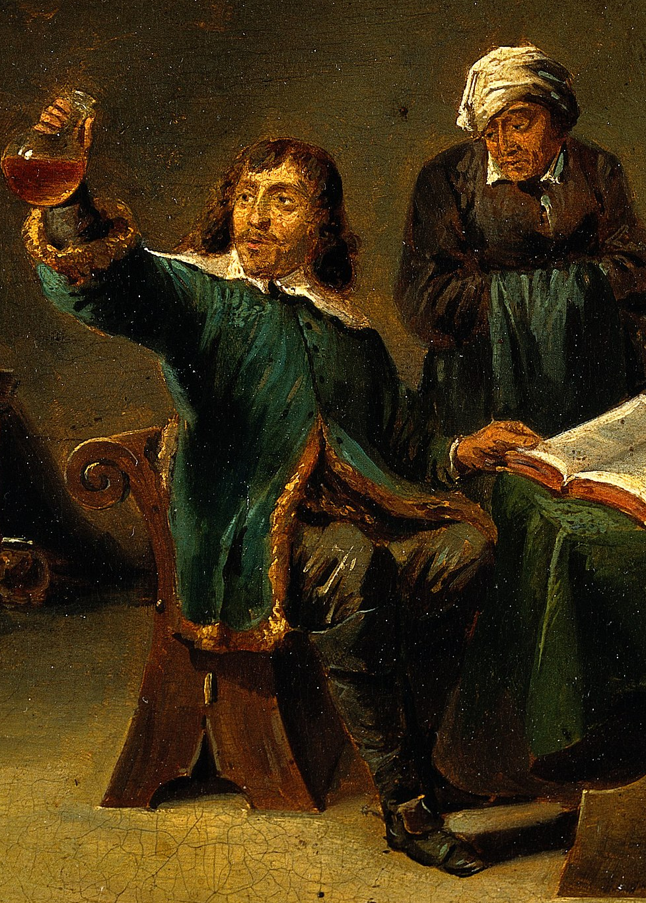
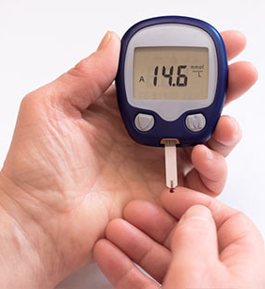
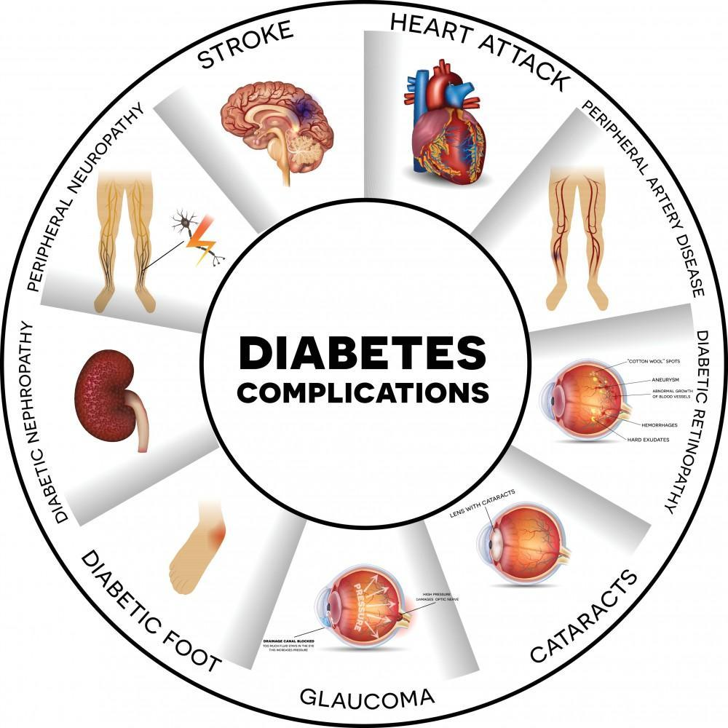
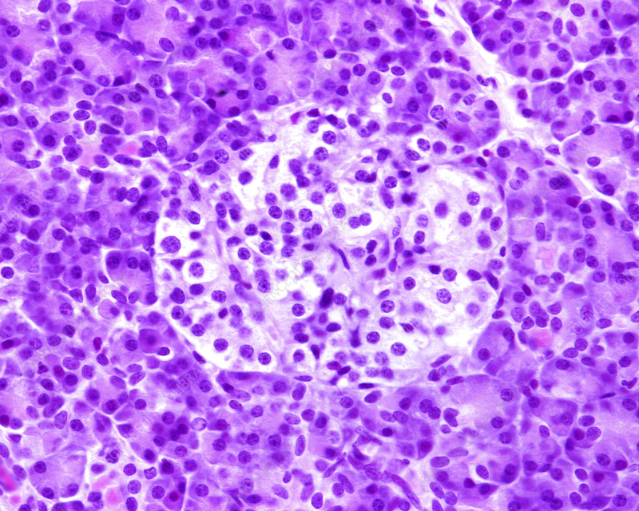

Previously on Diabetes…
History and discovery of the disease
Diabetes mellitus vs. insipidus
Normal blood glucose regulation
Type I, Type II, and gestational diabetes
Signs, symptoms, diagnosis, and complications
Notes:
Story of wasting child
Very common today – statistics next slide, most people will have personal experience
Topics – history, types of diabetes, normal physiology,

Slide 4


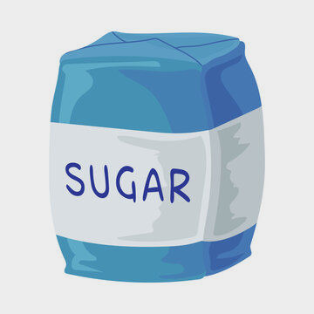
Our Story Continues…
Notes:
Story of wasting child
Very common today – statistics next slide, most people will have personal experience
Topics – history, types of diabetes, normal physiology,

Slide 5
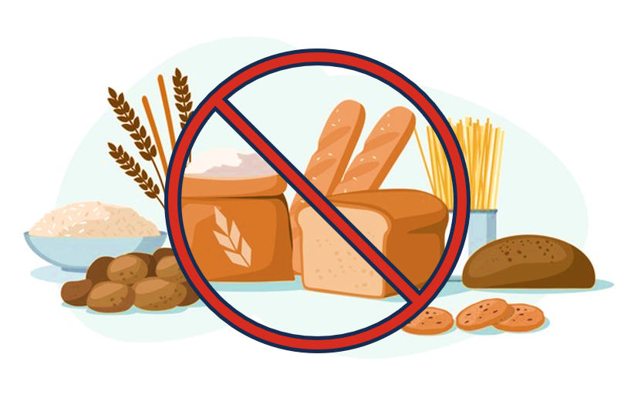
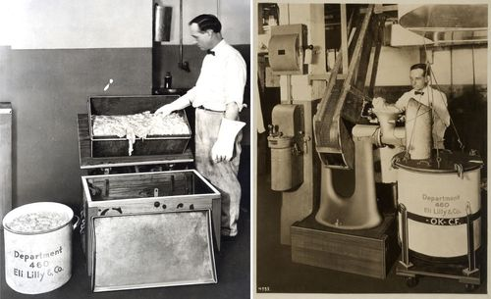
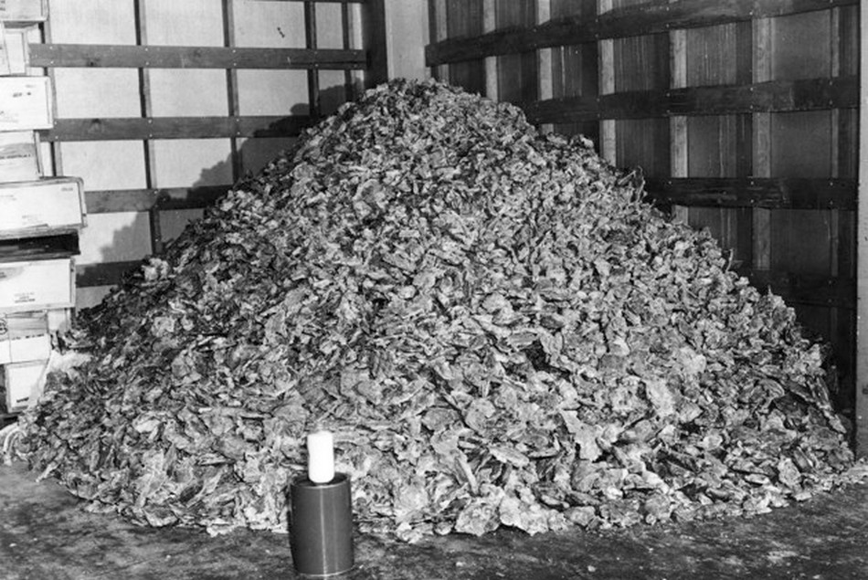
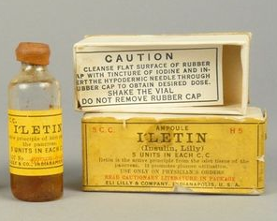
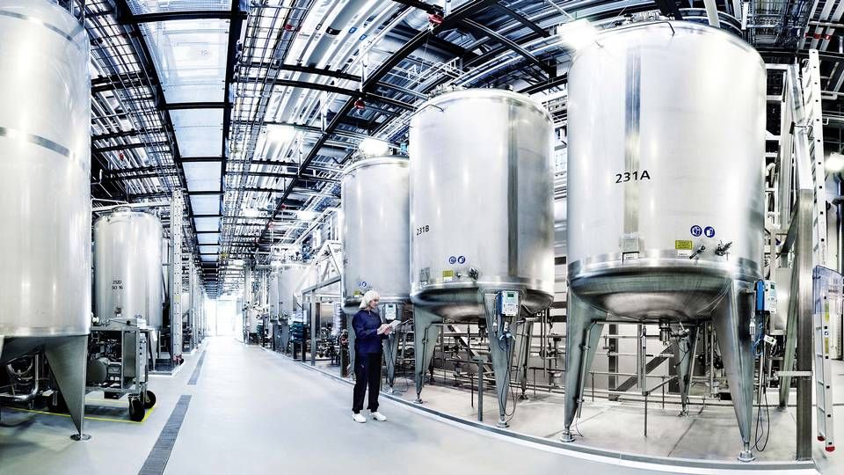
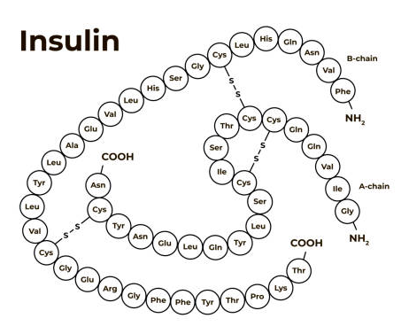
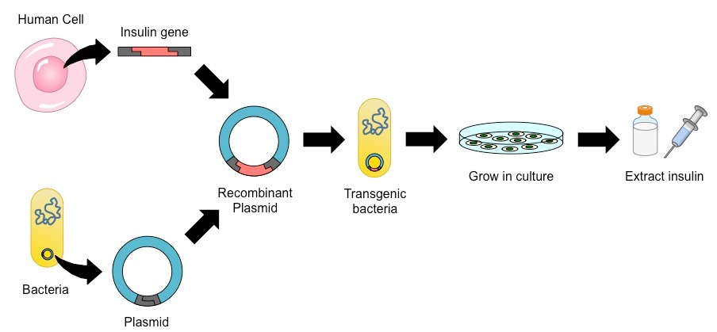
The Tale of Insulin
Before insulin – fasting and diet modification
1920’s - insulin purified from bovine and porcine pancreases
1950’s - Frederick Sanger determines amino acid sequence
1980’s - Biosynthetic human insulin using recombinant DNA technology
Notes:
As we saw, discovered in 1921
1000s of pounds of pancreases need for small amount of insulin, porcine differs by only 1 amino acid, discontinued by FDA in 2006
Sanger – British, won1958 Nobel prize in chemistry
Extracted by isoelectric precipitation – adjust pH until the right protein becomes neutral and precipitates out
By 1970’s transitioning to chromatography, more effective and efficient

Slide 6
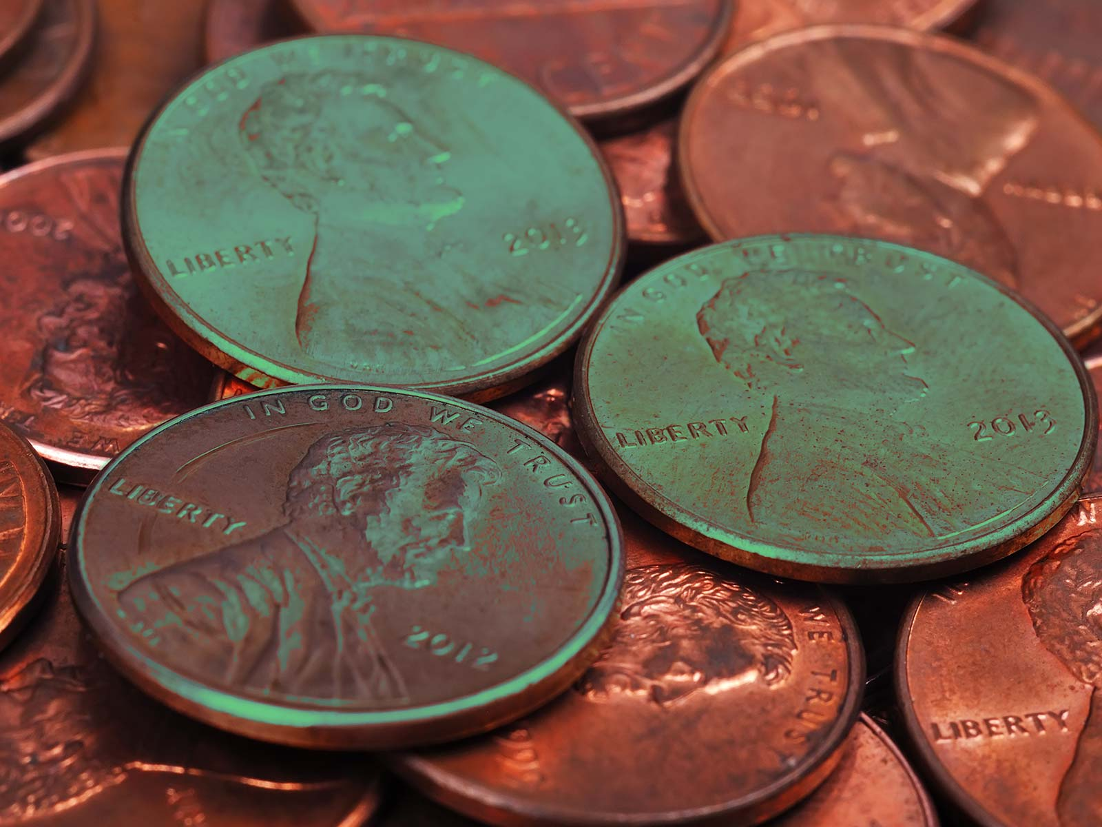
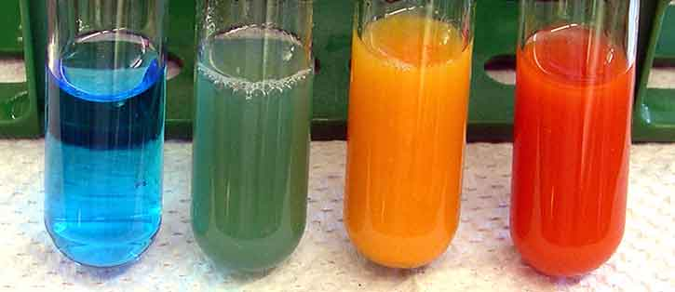
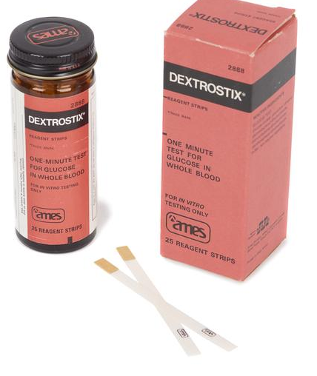
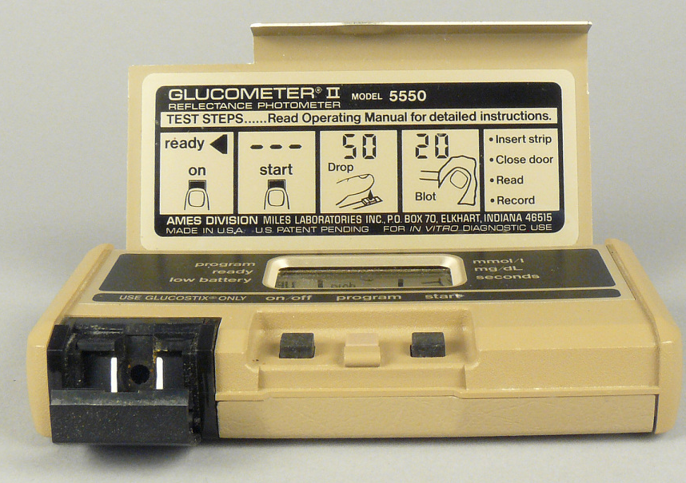
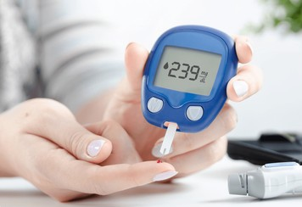
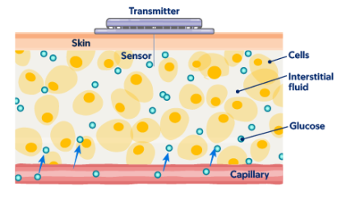
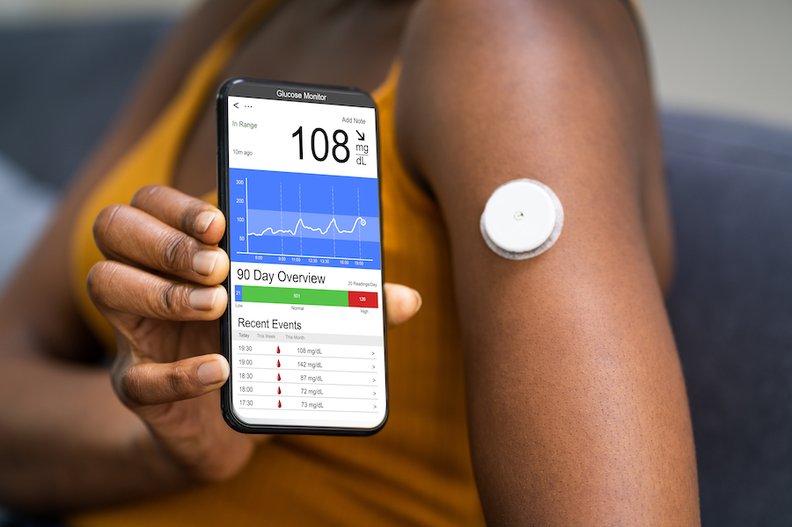
Glucose Monitoring
1908 – Stanley Benedict develops copper reagent for urine glucose
1965 - First blood glucose test strip developed (Dextrostix)
1980s – Glucose meters become available for home glucose monitoring,
Steady improvement over decades - less blood, less pain, more accuracy
2000’s – Continuous glucose monitoring
Notes:
Stanley Rossiter Benedict – from Cincinnati, taught chemistry and biochem in New York, early 20th C

Slide 7
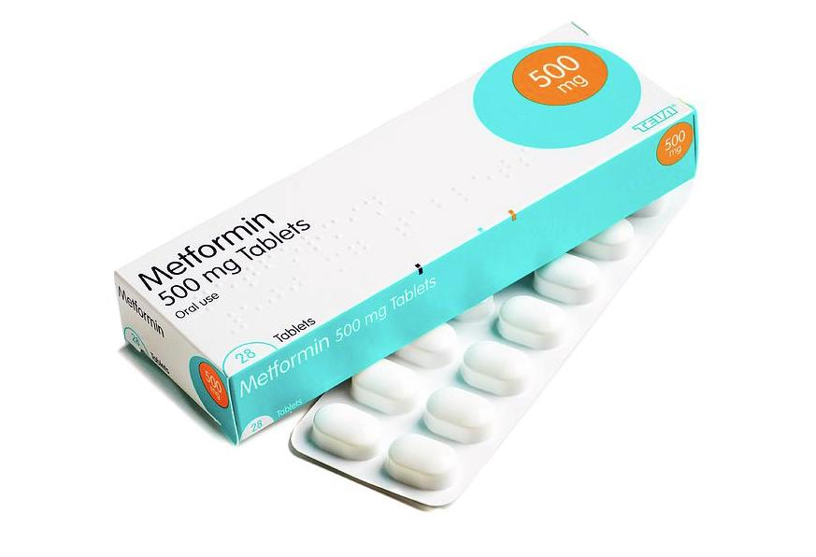
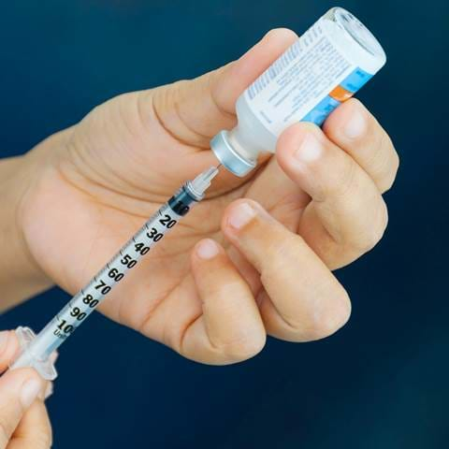
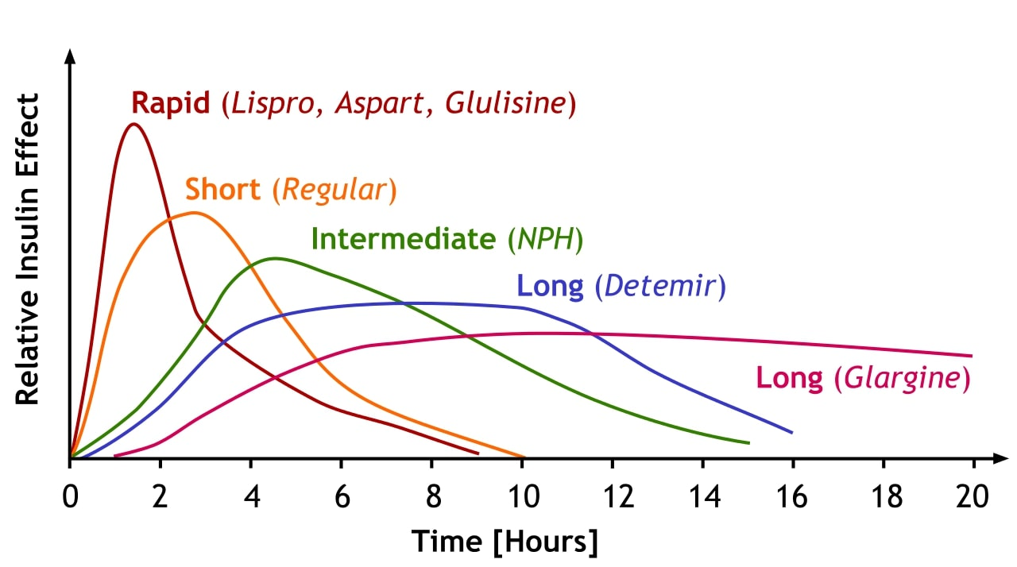
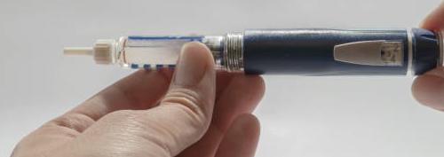
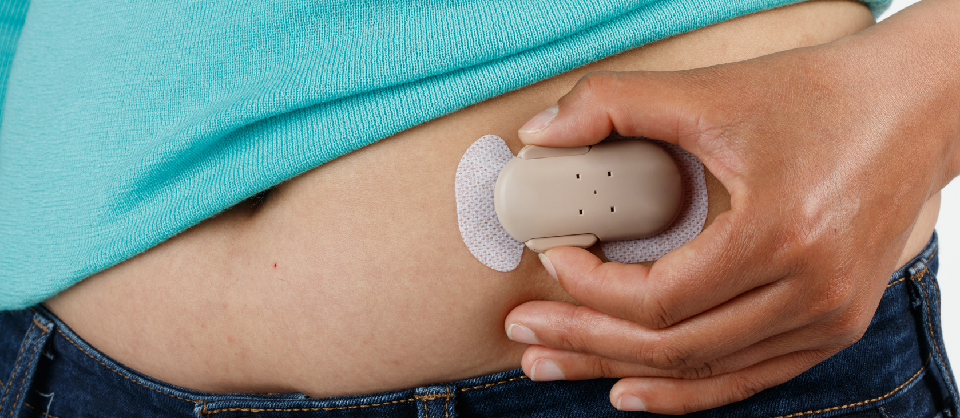
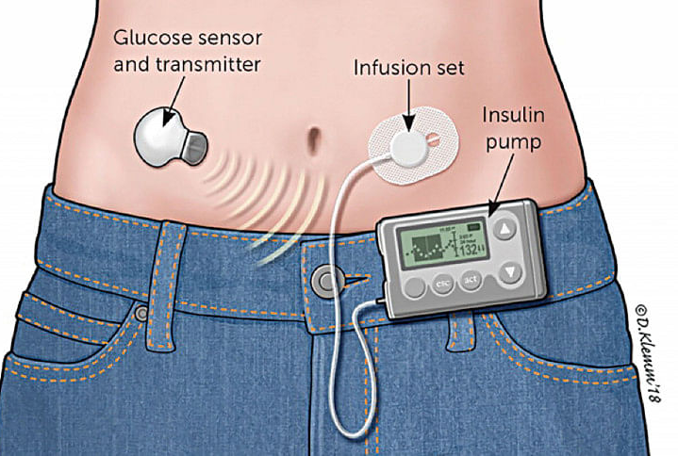
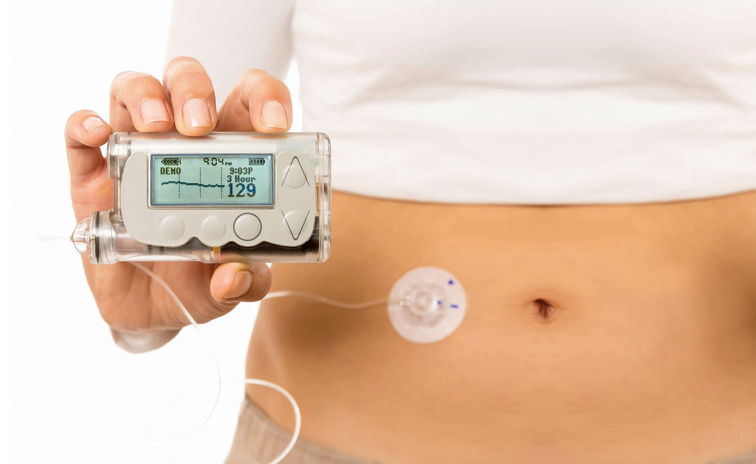
Medications
Injected insulin
Several subtypes
Oral medications
10 major classes of drugs with many mechanisms…
Increase insulin secretion
Decrease glucose release from liver
Make cells more responsive to insulin
Pens, patches, pods and pumps
Decrease glucose absorption in the gut
Block the kidney from retaining sugar
Artificial pancreas
Alter carbohydrate metabolism in cells
Promote weight loss
And more!

Slide 8
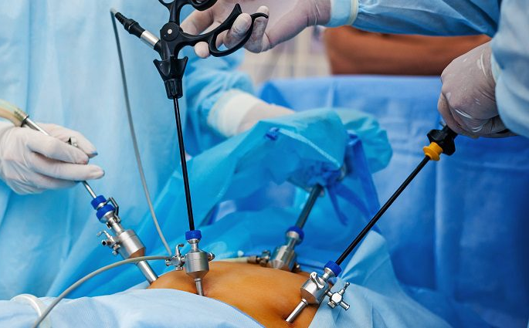
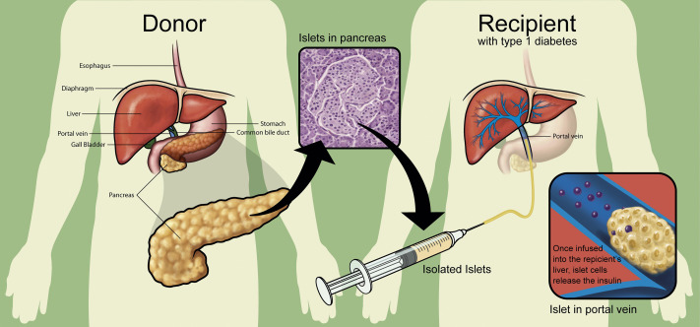
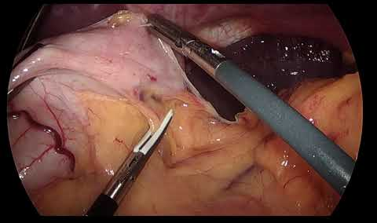
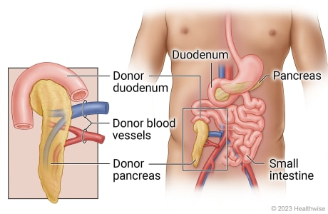
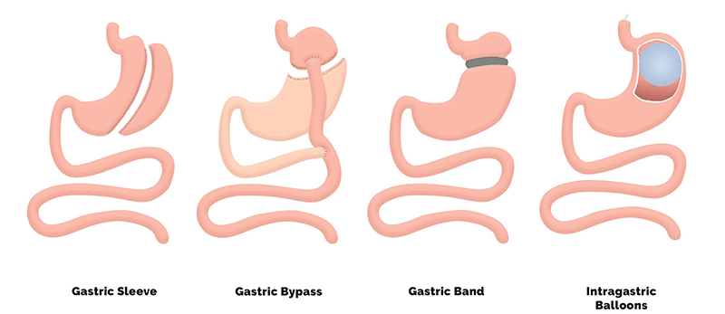
Surgical Treatments
Bariatric surgery
Gastric bypass
Sleeve gastrectomy
Lap band
Islet cell or pancreas transplant
Balloons

Slide 9
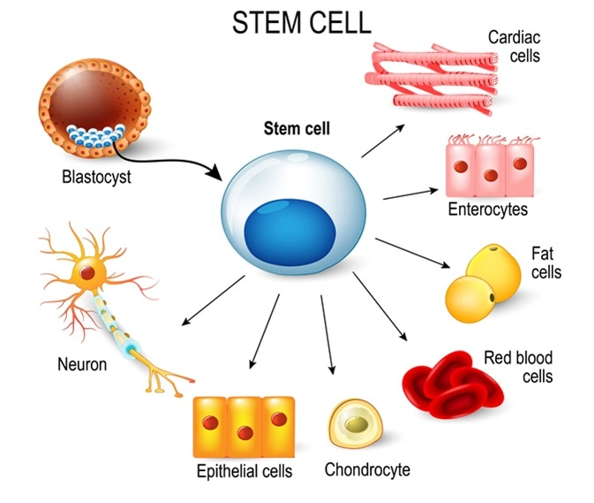
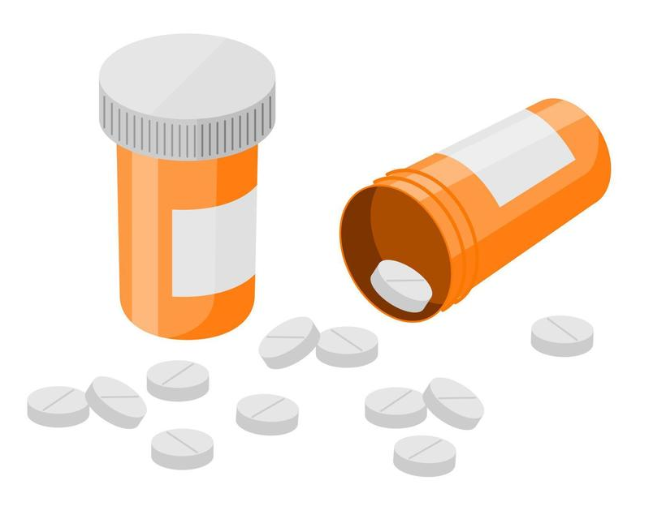

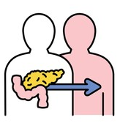
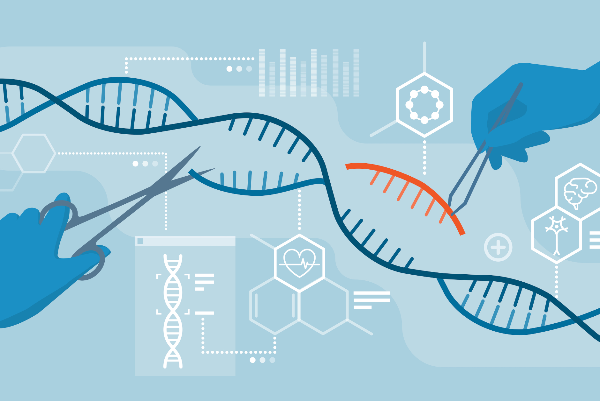
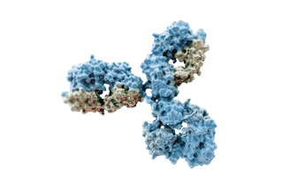
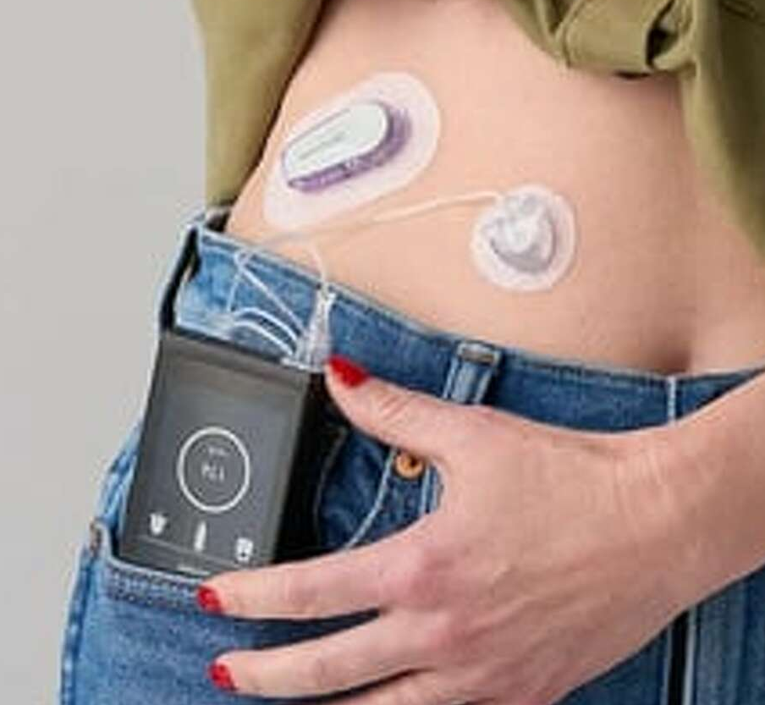
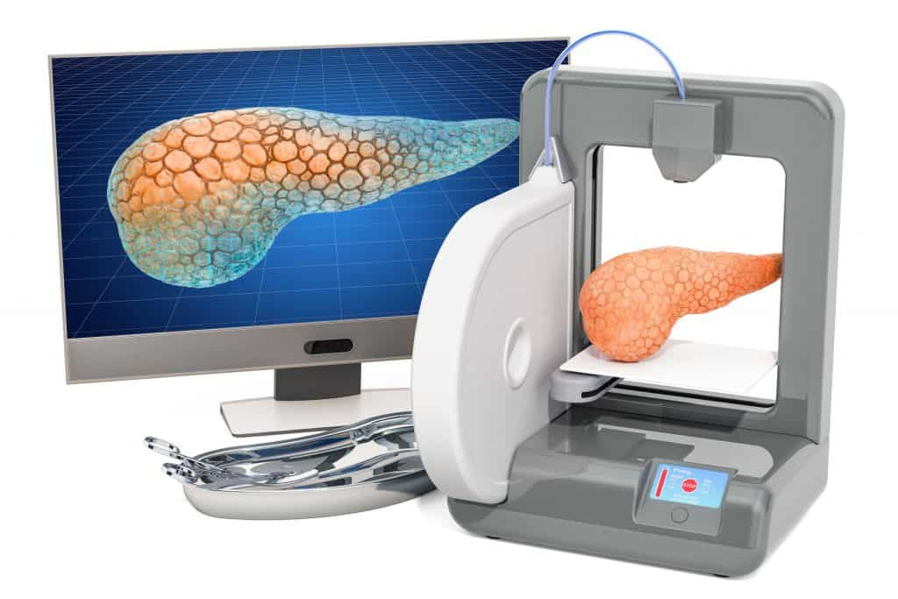
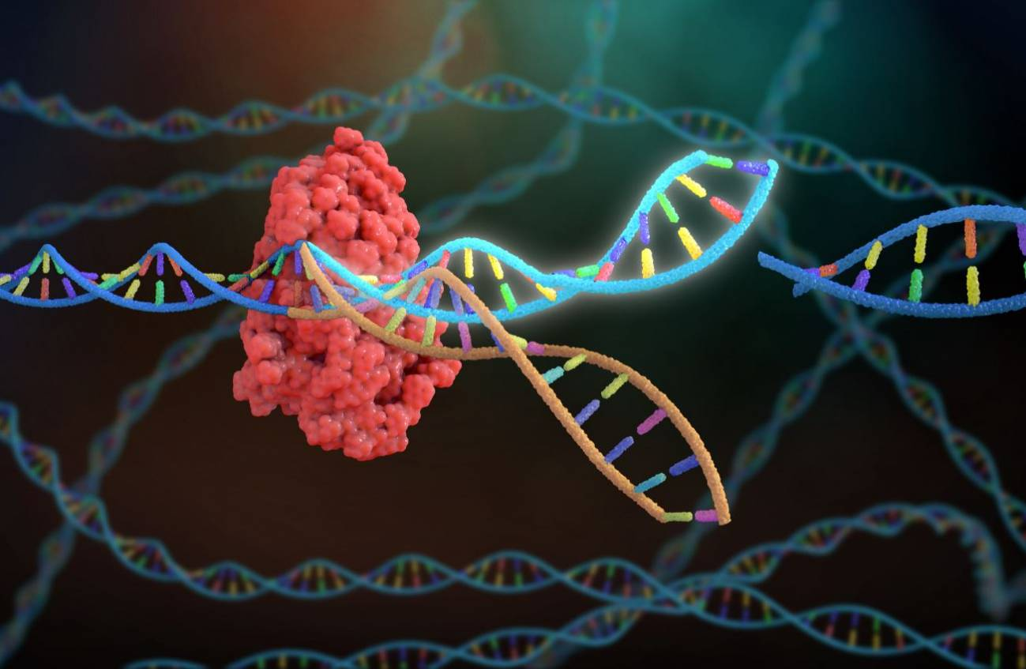
Future Treatments
Better prevention!
Stem cell therapies
New medications
Immunotherapy
Transplant improvements
Artificial pancreas improvements
Gene editing
3-D tissue printing
Notes:
Immunotherapy – prevent type 1, animal models successful – immunosuppression and regulation of T-cell destruction
Due to current HHS and NIH restructuring, the information provided on niddk.nih.gov is not being updated. Please refer to nih.gov

Slide 10


Beyond the pancreas…

Slide 11
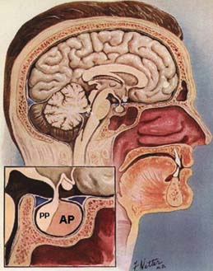
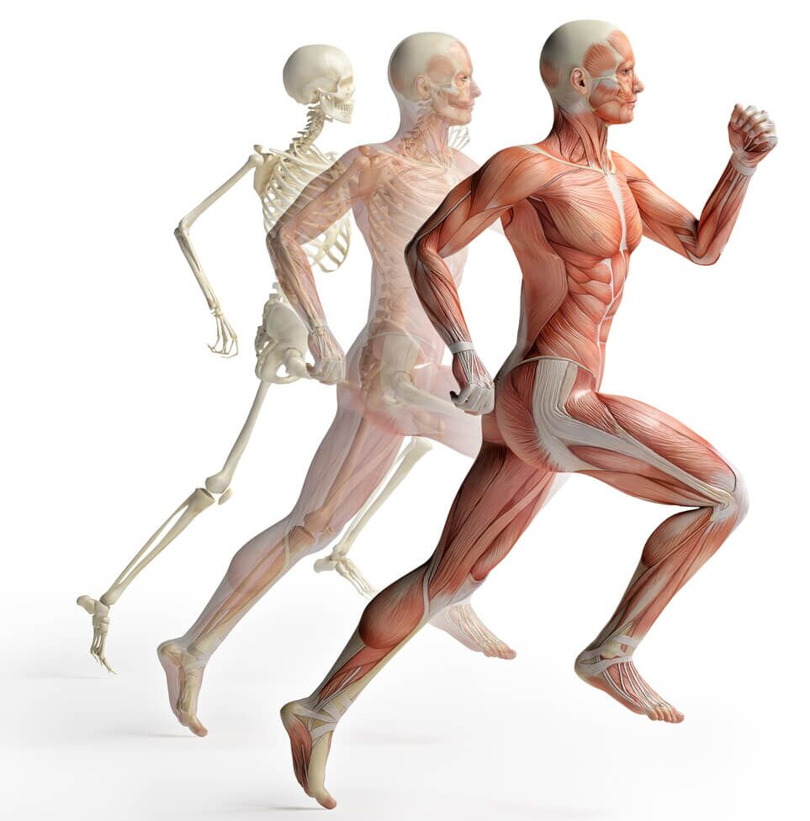
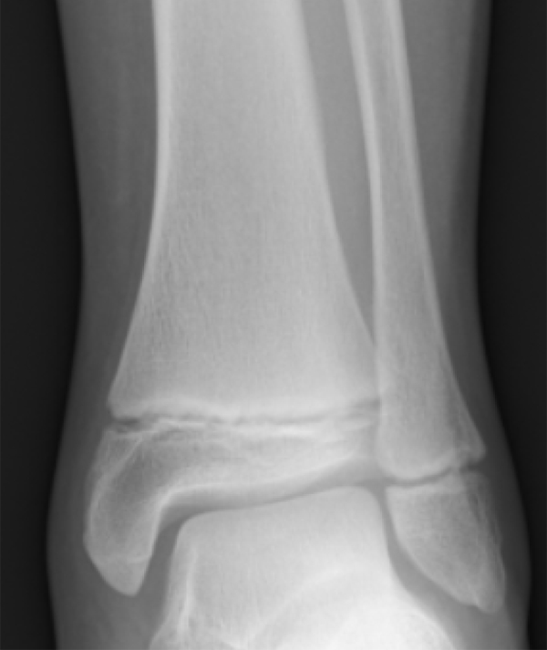
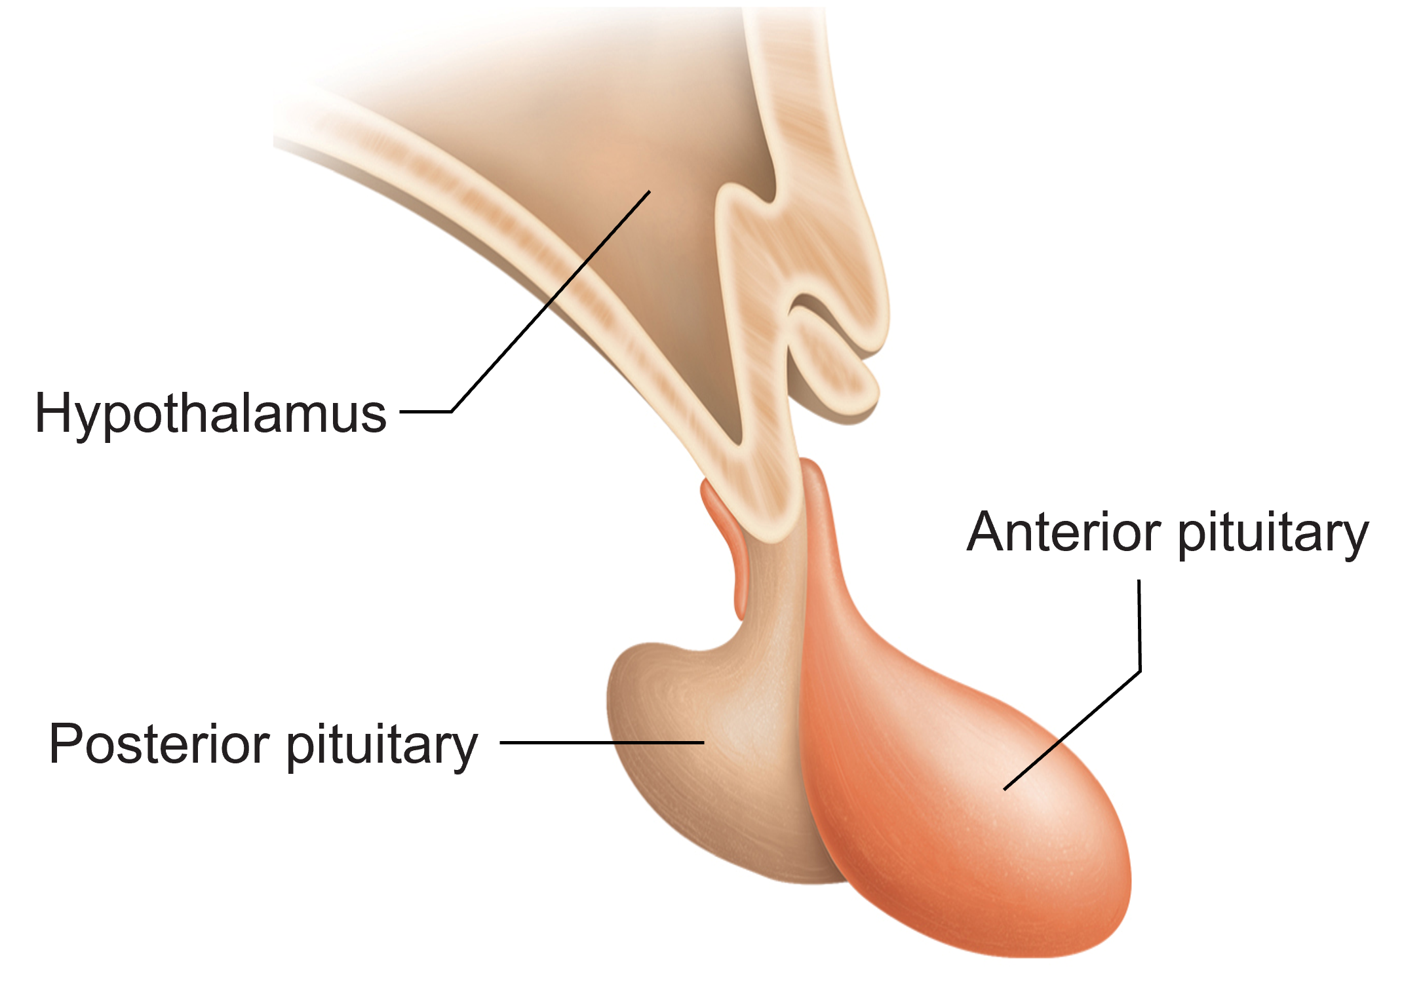
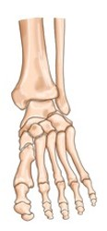
Growth Hormone
Made by the anterior pituitary gland
Regulated by the hypothalamus
Stimulates many tissues, especially:
Bone
Cartilage
Muscle
Liver
Fat
Nervous

Slide 12
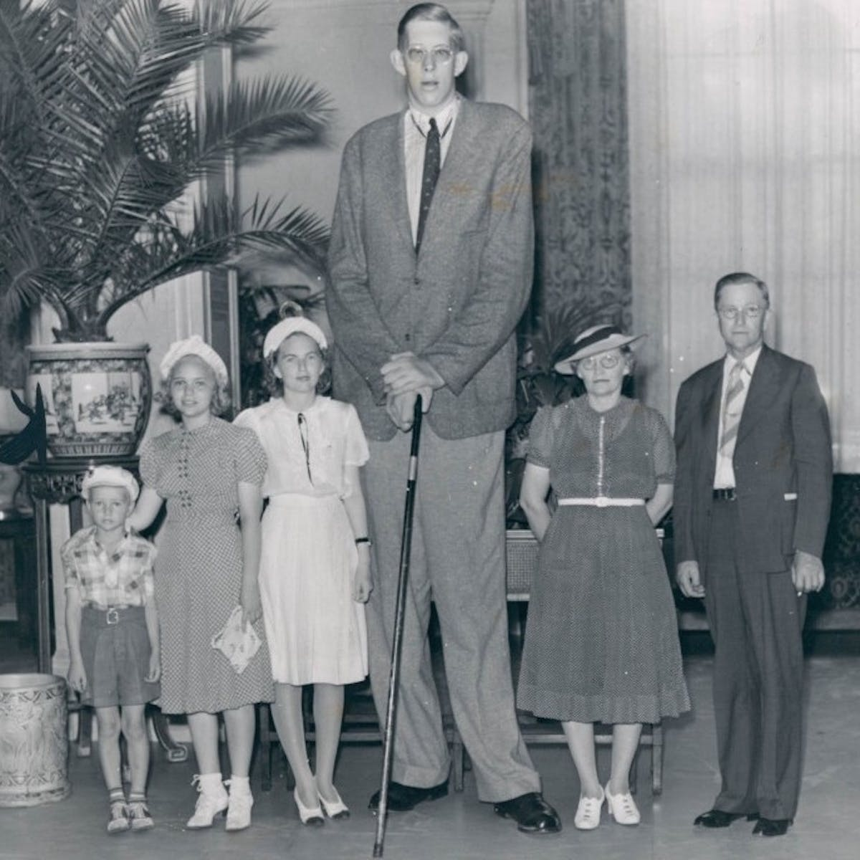




Growth Hormone Disorders
GH overproduction:
GH deficiency: Pituitary dwarfism
As a child: Gigantism
Compare to… Achondroplastic dwarfism
As an adult: Acromegaly

Slide 13






Thyroid Gland
Makes thyroid hormone (T3 and T4) to regulate metabolic rate
Stores thyroid hormone as colloid in thyroid follicles

Slide 14






Thyroid Hormone Disorders
Graves disease
Goiter
Exophthalmos

Slide 15








The Adrenal Gland
Activated during the stress response
Inner medulla releases adrenaline (epinephrine)
Outer cortex releases stress hormones such as cortisol
Increases heart rate, blood pressure, respiration, blood glucose, suppresses immune response

Slide 16






Adrenal Gland Disorders
Hypercortisolism (Cushing’s disease, Cushing’s syndrome)
Adrenal Insufficiency (Hypoadrenalism, Addison’s disease)

Slide 17


Thank you!
Questions?

